Slide 1
Local Economic Outlook
Silicon Valley US-China
Economic & Technology Forum
October 26, 2012
Tom Means
Director, Council for Economic Education
San Jose State University
Slides available at http://www.sjsu.edu/people/tom.means/

Slide 2
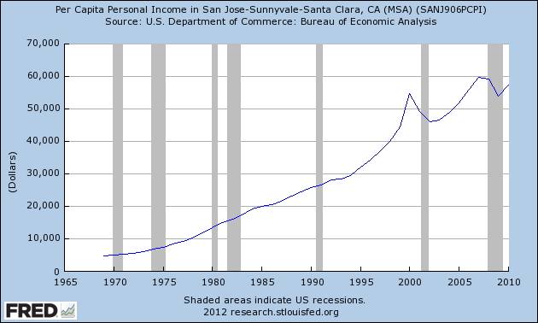
Per Capita Income 1969-present

Slide 3
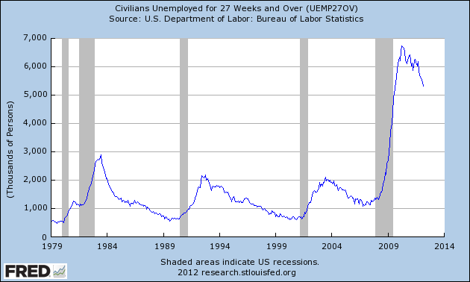
Civilians Unemployed > 27 weeks
1979 - present

Slide 4
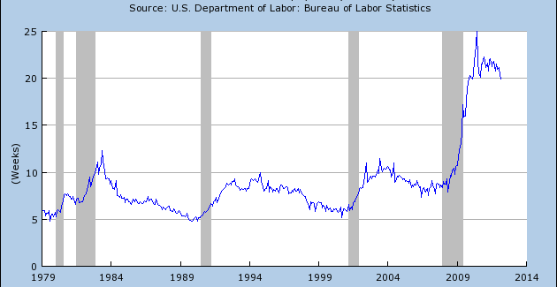
Median Weeks Unemployed
1979 – present

Slide 5
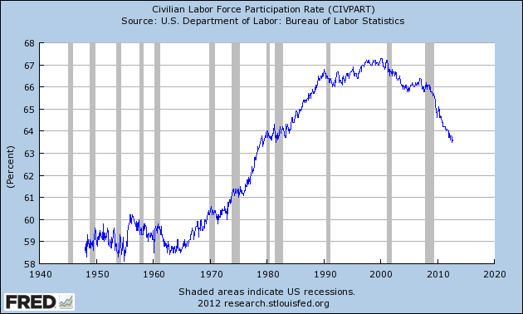
Civilian Labor Force Participation Rate
1947 – present

Slide 6
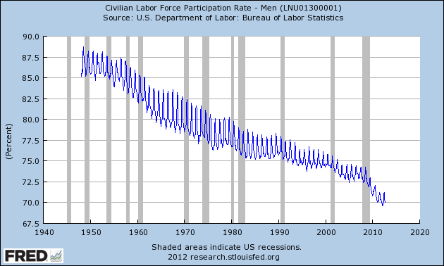
CLFPR – Men
1947 - present

Slide 7
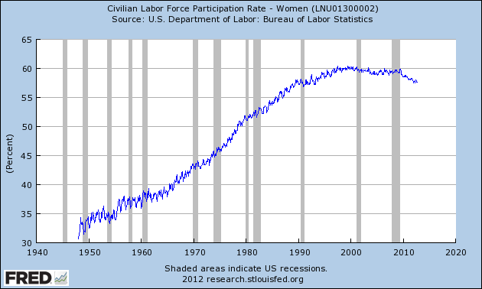
CLFPR – Women
1947 - present

Slide 8
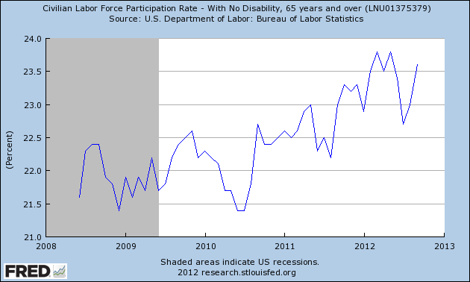
CLFPR – 65 years and over
2008 - present

Slide 9
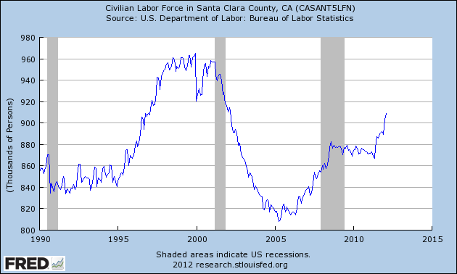
CLF – Santa Clara County
1990 – present

Slide 10
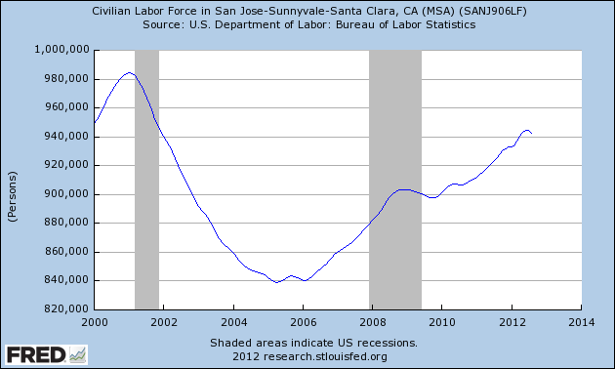
CLF – San Jose (MSA)
2000 – present

Slide 11
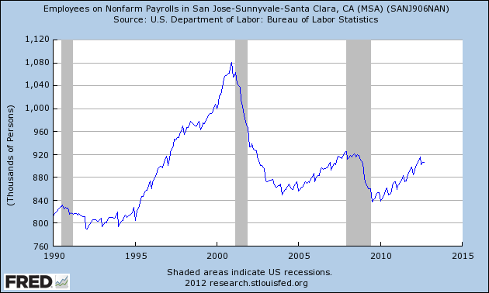
Private Employment
SJ-MSA, 1990 – present

Slide 12
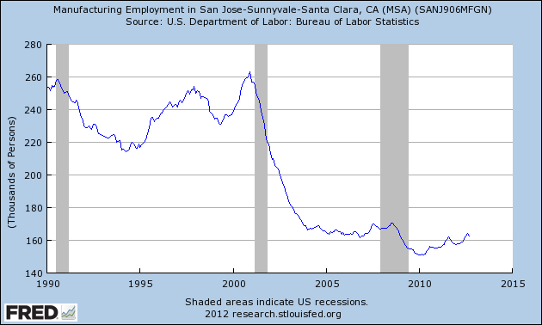
Manufacturing Employment
SJ-MSA, 1989 – present

Slide 13
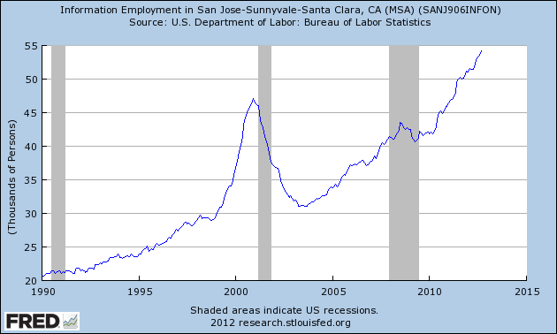
Information Employment
SJ-MSA, 1989 - present

Slide 14
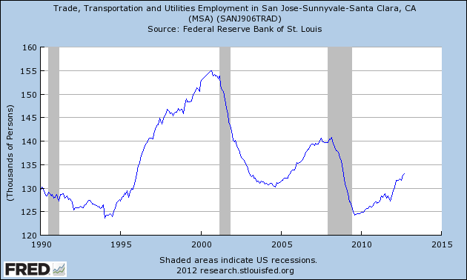
Trade, Transportation & Utilities
SJ-MSA, 1989 - present

Slide 15
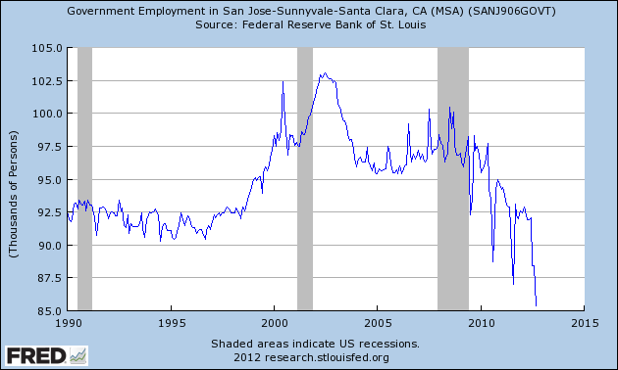
Government Employment
SJ-MSA, 1989 - present

Slide 16
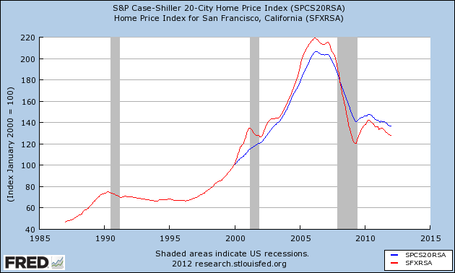
Home Price Index 1987-present

Slide 17
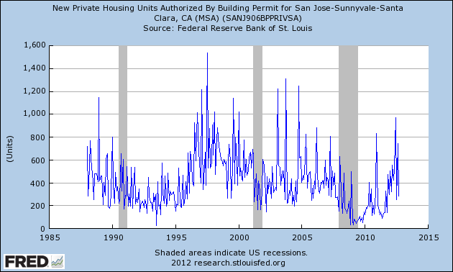
Housing Permits
SJ-MSA, 1987 - present

Slide 18
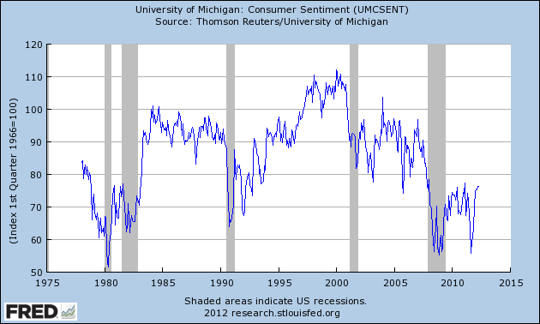
Consumer Sentiment, 1978-present

Slide 19
Questions?

