Slide 1
Child Psyc., Lec. 2 8-28
Three families in text
The nature of development
  Orderly, cumulative, directional
  Heinz Werner
Qualitative versus Quantitative change
Qualitative – may involve reorganization
Normative versus individual
Frameworks
Evolutionary
Heredity and Environment
Six major theories of development
  Piaget
  Information-Processing theories
  Sociocultural theories
  Psychoanalytic
  Social Learning
  Bowlby’s adaptational

Slide 2
Stories of Three Families
Focus groups with community members and developmental psychologists.
Professional writers
Although they have been updated you may find them somewhat out of date
Limited diversity

Slide 3
The nature of development
  Orderly,
  cumulative,
  directional

Slide 4
Heinz Werner (1890-1964)
Differentiation and Hierarchic Integration
Spiral of Development

Slide 5
Qualitative versus Quantitative Change
Quantitative Change
  Size, weight, strength, number of words in vocabulary
Qualitative Change (emergence and reorganization)
  No language to language
  Not walking to walking
  Sense of self
Is it an issue of development or of they type of theoretical concepts.

Slide 6
Normative versus Individual Development
Normative—average
Individual development
  Variation in rate
  Differences in course of development
  (capital, alienation, and challenge)

Slide 7
Frameworks for Conceptualizing Development
Evolutionary
  Adaptation
Heredity and Environment
  Always both (language example)
  The influence goes both ways
    How you experience the environment
    Genes that are selected
    Genes that are expressed (epigenisis)

Slide 8
Six Major Theories of Development
  Piaget
  Information-Processing theories
  Sociocultural theories
  Psychoanalytic
  Social Learning
  Bowlby’s adaptational

Slide 9
Piaget’s Theory (1896 – 1980)
Trained in Biology
Interested in what he called Genetic Epistomology
Thought he could solve the major issues in a decade or two but spent his life working on it.
Focused on Qualitative Change in cognition
Strong advocate of an interactionist position regarding nature and nurture
Constructivist theory

Slide 10
Piaget’s theory (cont.)
Structural Invariants
  Adaptation (assimilation and accommodation)
  Organization
  Equilibration
Stage theory: “If we now consider only the principal periods of development, one can enumerate three of them” Piaget, J. (1970) Piaget’s theory. In Charmichael’s Manual of Child Psychology.
  Sensorimotor operations
  Concrete operations
  Formal Operations

Slide 11
Information Processing Theory
Based on Atkinson & Shiffrin (1969) model
Input->Sensory Memory-> Short-term memory<->Long-term Memory
Book says the focus is on quantitive change, which was true initially but now involves both quantitative and qualitative change
  Bob Sigler’s work on addition

Slide 12
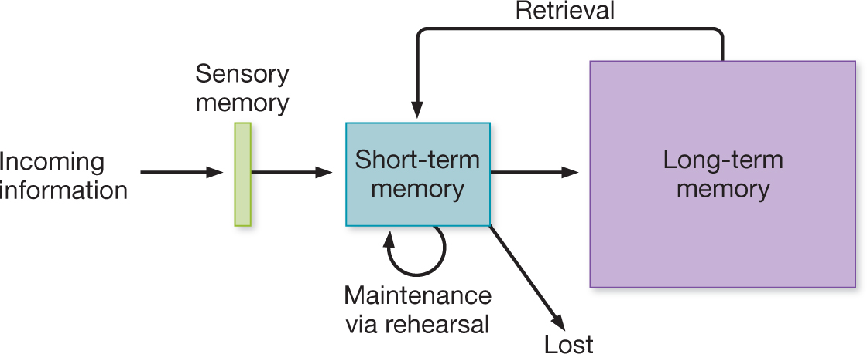
Atkinson & Shiffrin (The Modal Model)
Information processing approaches
Each of these systems is separate
Notes:
A perspective in cognitive psychology in which complex mental events involve a number of discrete components
These components receive input from, and sent input to, one another.

Slide 13
Lev Vygosky (1896—1934) and Sociocultural theory
Importance of social context of development
Quantitative and qualitative change
Little focus on nature/nurture issue
  Social speech->private speech->inner speech
  Zone of proximal development
  Scaffolding
Rogoff—learning through observing and participation

Slide 14
Psychoanalytic Theory
Freud (1856 – 1939)
  Id – there from the beginning
  Ego and Superego – develop over time
  Psychosexual stages
Erikson (1902 – 1994)
  Similar to freud
  Stages address a broader range of issues
  Dealt explicitly with differences among cultures

Slide 15
Stage | Age | Freud’s Psychosexual Stages | Erikson’s Psychosocial Stages
1 | 0 -- 1 | Oral | Basic trust vs. mistrust
2 | 1 -- 3 | Anal | Autonomy vs. Shame & Doubt
3 | 3 – 6 | Phallic | Initiative vs. Guilt
4 | 7 -- 11 | Latency | Industry vs. Inferiority
5 | 12 – 18 | Genital | Identity vs. Role Confusion
6 | Young adulthood |  | Intimacy vs. Isolation
7 | Adulthood |  | Generativity vs. Stagnation
8 | Maturity/Old Age |  | Ego integrity vs. Despair

Slide 16
Social Learning Theory
Albert Bandura (1925 -- )
Outgrowth of Learning Theory
The course of development is a consequence of a child’s particular learning history
Increased the number of learning mechanisms which function throughout the lifespan
  Immitation
  Observational learning
Characteristics of the situation, the person modeling a behavior or providing reinforcement, the relationship of the learner to others, and a variety of other characteristics are all moderators of learning.

Slide 17
Bowlby’s (1908 – 1990) Adaptational Theory
Influenced by Freud and Darwin
Babies arrive with predispositions
Early social relationships are key to later development.
Cognitive skills and the development of an inner working model guide social behavior.
“Attachment” is a key concept.

Slide 18
Major Issues
Gradual versus stage models of development.
The relative importance of early versus current experience in guiding development.
Specificity versus generality of developmental acquisitions.

