Slide 1
Six major theories of development
Piaget
Information-Processing theories
Sociocultural theories
Psychoanalytic
Social Learning
Bowlby’s adaptational theory
Major issue
Gradual versus stage
Early versus current experience
Specificity versus generality
Methods
Experiments
Natural experiments
Naturalistic observation
Longitudinal versus cross-sectional versus cross-sequential (accelerated longitudinal design)
Cohort effects
Attrition
Challenges of doing research with children of different ages
Challenges of doing research with children from different cultures

Slide 2
Note on my web sites
Browsers try to be efficient.
Store information they have loaded before.
So if information doesn’t come up when you reload a web page, clear you’re the buffer in your browser. There is usually a button labeled something like “Clear recent history” under the “Tools” or “History” menu, depending on the browser you are using.

Slide 3
Review from last class
From our historical review we identified three approaches to development
  Preformationist
  Predeterminist
  Empiricist
Components of Piaget’s theory
  Functional invarients: adaptation, organization, equilibration
  The major periods: sensorimotor, concrete operations, formal operations
Information processing theory was described

Slide 4
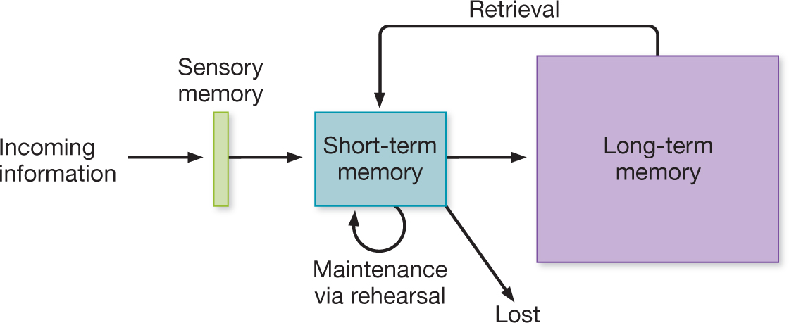
Atkinson & Shiffrin (The Modal Model)
Information processing approaches
Each of these systems is separate
Notes:
A perspective in cognitive psychology in which complex mental events involve a number of discrete components
These components receive input from, and sent input to, one another.

Slide 5
Lev Vygosky (1896—1934) and Sociocultural theory
Importance of social context of development
Quantitative and qualitative change
Little focus on nature/nurture issue
  Social speech->private speech->inner speech
  Zone of proximal development
  Scaffolding
Rogoff—learning through observing and participation

Slide 6
Lev Vygosky (1896—1934) and Sociocultural theory
Importance of social context of development
Quantitative and qualitative change
Little focus on nature/nurture issue
  Social speech->private speech->inner speech
  Zone of proximal development
  Scaffolding
Rogoff—learning through observing and participation

Slide 7
Psychoanalytic Theory
Freud (1856 – 1939)
  Id – there from the beginning
  Ego and Superego – develop over time
  Psychosexual stages
Erikson (1902 – 1994)
  Similar to freud
  Stages address a broader range of issues
  Dealt explicitly with differences among cultures

Slide 8
Stage | Age | Freud’s Psychosexual Stages | Erikson’s Psychosocial Stages
1 | 0 -- 1 | Oral | Basic trust vs. mistrust
2 | 1 -- 3 | Anal | Autonomy vs. Shame & Doubt
3 | 3 – 6 | Phallic | Initiative vs. Guilt
4 | 7 -- 11 | Latency | Industry vs. Inferiority
5 | 12 – 18 | Genital | Identity vs. Role Confusion
6 | Young adulthood |  | Intimacy vs. Isolation
7 | Adulthood |  | Generativity vs. Stagnation
8 | Maturity/Old Age |  | Ego integrity vs. Despair

Slide 9
Social Learning Theory
Albert Bandura (1925 -- )
Outgrowth of Learning Theory
The course of development is a consequence of a child’s particular learning history
Increased the number of learning mechanisms which function throughout the lifespan
  Immitation
  Observational learning
Characteristics of the situation, the person modeling a behavior or providing reinforcement, the relationship of the learner to others, and a variety of other characteristics are all moderators of learning.

Slide 10
Bowlby’s (1908 – 1990) Adaptational Theory
Influenced by Freud and Darwin
Babies arrive with predispositions
Early social relationships are key to later development.
Cognitive skills and the development of an inner working model guide social behavior.
“Attachment” is a key concept.

Slide 11
Major Issues
Gradual versus stage models of development.
The relative importance of early versus current experience in guiding development.
Specificity versus generality of developmental acquisitions.

Slide 12
Methods in Developmental Psychology
Like personality psychology, developmental psychology is, in part, correlational
  One cannot assign personality or age randomly to set of participants.
However, in other aspects, developmental psychology uses the full range of methodologies used in other areas within psychology

Slide 13
Experiments
Advantage – clearly establishes causality
Problem– many of the things we would like to investigate it would be unethical to intentionally do to a child to investigate its effect (e.g., child abuse, starvation)
Natural experiments provide a partial solution to this limitation

Slide 14
Naturalistic Observation
Advantage – ecological validity
Disadvantages:
  Many uncontrolled variables
  Usually not a random sample

Slide 15
Design of Developmental Studies
Longitudinal – to understand changes with age follow the same children as they grow older
Crossectional – study groups of children of different ages and “presume” the differences between the age groups are a consequence of development.
Cross-sequential (accelerated longitudinal) – combines the two designs above. Is particularly good for revealing cohort effects and helps in understanding non-random attrition.

Slide 16
Challenges of working with different age groups
Does the task mean the same thing at different ages.
Ceiling and floor effects.

Slide 17
Challenges of doing research with children from different cultures
Does the task mean the same thing to individuals from different cultures.
Do they respond to research situations similarly.
What norms do you use?

