Slide 1
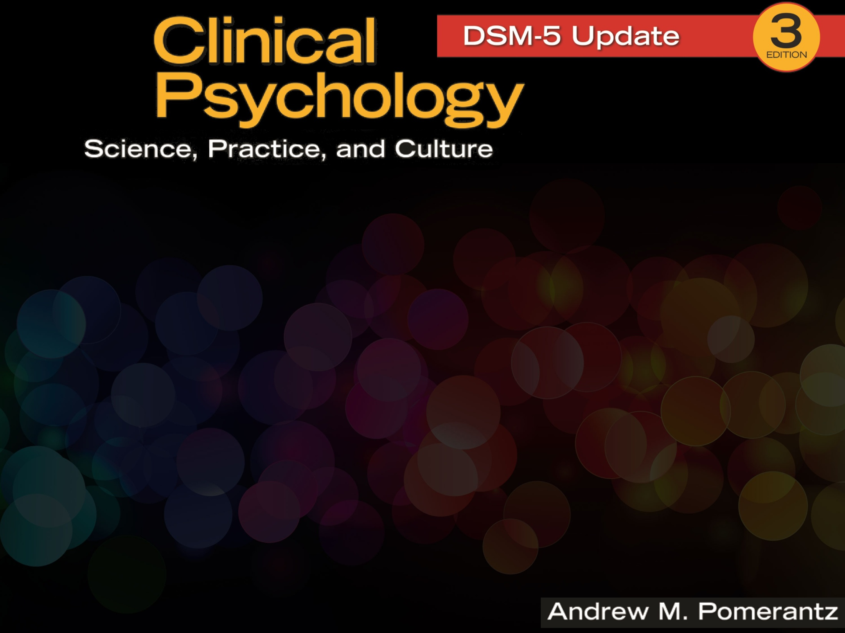
Chapter 1
Clinical Psychology: Definition and Training

Slide 2
Clinical Psychology
“Clinical psychology” first used in 1907 by Lightner Witmer
Originally defined as similar to medicine, education, and sociology
Notes:
Witmer was the first to operate a psychological clinic; the first clients were children with behavioral or educational problems.

Slide 3
More Recent Definitions
Tremendous growth has resulted in a very broad, hard-to-define field
Brief definitions emphasize the study, assessment, and treatment of people with psychological problems
More detailed definitions (e.g., Division 12 of APA) are more inclusive and descriptive
Notes:
Concise definitions fall short of capturing the field in its entirety. Contemporary clinical psychologists do many different things, with many different goals, for many different people.

Slide 4
APA Division 12 Definition of Clinical Psychology
“The field of Clinical Psychology integrates science, theory, and practice to understand, predict, and alleviate maladjustment, disability, and discomfort as well as to promote human adaptation, adjustment, and personal development. Clinical Psychology focuses on the intellectual, emotional, biological, psychological, social, and behavioral aspects of human functioning across the life span, in varying cultures, and at all socioeconomic levels.” (APA, 2012)
Notes:
An accurate, comprehensive, contemporary definition of clinical psychology needs to be more inclusive and descriptive, such as that provided by the APA.
The field and practitioners of clinical psychology continue to outgrow classical definitions.

Slide 5
Education and Training in Clinical Psychology
Commonalities among most training programs
  Doctoral degree
  Most enter with bachelor’s, some with master’s degree
  Required coursework
  Thesis/dissertation
  Predoctoral internship (more information in later slides)
Notes:
About 2,800 doctoral degrees in clinical psychology are awarded each year.

Slide 6
Education and Training: Specialty Tracks
In recent decades, specialty tracks have emerged, including:
  Child
  Health
  Forensic
  Family
  Neuropsychology
More on these specialty areas in later chapters
Notes:
More than half of APA-accredited doctoral programs offer training within a specialty track.

Slide 7
Three Models of Training
Scientist-practitioner model (or Boulder model)
Practitioner-scholar model (or Vail model)
Clinical scientist model

Slide 8
Scientist-Practitioner Model (Boulder Model): Balancing Practice and Science
Created in 1949 at a conference in Boulder, Colorado of directors of clinical psychology training programs
Emphasizes both practice and research
  Graduates should be able to competently practice (e.g., therapy, assessment) and conduct research
  A balanced approach
Notes:
Graduate students would need to receive training and display competence in the application of clinical methods (assessment, psychotherapy, etc.) and the research methods necessary to scientifically study and evaluate the field.
These graduate programs would continue to be housed in departments of psychology at universities, and graduates would be awarded the PhD degree.

Slide 9
Practitioner-Scholar Model (Vail Model): Emphasizing Practice
Created in 1973 in a conference in Vail, Colorado
Also known as practitioner-scholar model
Emphasizes practice over research
Yields the Psy.D. degree (not the traditional Ph.D.)
Higher acceptance rates and larger classes
Proliferated in recent years

Slide 10
Ph.D. vs Psy.D.
Emphasize practice and research
Smaller classes
Lower acceptance rate
Typically in university departments
Offer more funding to students
Greater success in placing students in APA-accredited internships
Emphasize practice over research
Larger classes
Greater acceptance rate
Often in free-standing professional schools
Offer less funding to students
Less success in placing students in APA-accredited internships
Notes:
See Box 1.1 Comparing Ph.D. Programs With Psy.D. Programs and Table 1.1 Compairson of Psy.D. and Ph.D. Programs in Clinical Psychology

Slide 11
Clinical Scientist Model: Emphasizing Research
Emerged in 1990s, primarily as a reaction against the trend toward practice represented by Vail model
Richard McFall’s 1991 “Manifesto for a Science of Clinical Psychology” sparked this movement
A subset of Ph. D. institutions who strongly endorse empiricism and science
Tend to train researchers rather than practitioners
Notes:
From McFall’s (1991) manifesto: “…scientific clinical psychology is the only legitimate and acceptable form of clinical psychology . . . after all, what is the alternative? . . . Does anyone seriously believe that a reliance on intuition and other unscientific methods is going to hasten advances in knowledge?” (pp. 76–77)

Slide 12
Emerging Trends in Training
Technology
  Use of webcams for supervision
  Computer-based assessment
Competencies
  Skills that a student must demonstrate
  Ex. Intervention, assessment, research, etc.
Notes:
Emphasizing competencies ensures that the students who graduate from clinical psychology programs will not only have earned good grades on exams, papers, and other academic tasks, but will be able to apply what they have learned as well.

Slide 13
Sample Grad Program
Website Self-Description
Boulder model example: University of Alabama
  “…graduates function in a variety of settings as teachers, researchers, and providers of clinical services… The program emphasizes the integration of scientific knowledge and the professional skills and attitudes needed to function as a clinical psychologist in academic, research, or applied settings.”

Slide 14
Sample Grad Program
Website Self-Description
Vail model example: Chicago School of Professional Psychology
  “As a professional school, our focus is not strictly on research and theory, but on preparing students to become outstanding practitioners, providing direct service to help individuals and organizations thrive.”

Slide 15
Sample Grad Program
Website Self-Description
Clinical scientist model example: Indiana University
  “Indiana University’s Clinical Training Program is designed with a special mission in mind: To train first-rate clinical scientists… applicants with primary interests in pursuing careers as service providers are not likely to thrive here.”

Slide 16
Getting in to Graduate School in Clinical Psychology
Know your professional options
Take the appropriate undergraduate courses
Get to know your professors
Get research experience
Get clinically relevant experience
Maximize your GRE score
Select graduate programs wisely
Write effective personal statements
Prepare well for admissions interviews
Consider your long-term goals
Notes:
On average, PhD programs in clinical psychology receive 270 applications and admit only 6% of them.

Slide 17
Internships: Predoc and Postdoc
Predoctoral internship
  Takes place at the end of doctoral training programs (before Ph.D. or Psy.D. is awarded)
  A full year of supervised clinical experience in an applied setting
  An apprenticeship of sorts, to transition from student to professional
Notes:
In some years, the number of graduate students seeking predoctoral internships has either approached or exceeded the number of available slots.

Slide 18
Internships: Predoc and Postdoc
Postdoctoral internship
  Takes place after the doctoral degree is awarded
  Typically lasts 1-2 years
  Still supervised, but more independence
  Often specialized training
  Often required for state licensure

Slide 19
Getting Licensed
Licensure enables independent practice and identification as a member of the profession
Requires appropriate graduate coursework, postdoctoral internship, and licensing exams
Each state has its own licensing requirements
To stay licensed, most states require continuing education units (CEUs)

Slide 20
Where Do Clinical Psychologists Work?
A variety of settings, but private practice is most common
  True since 1980s
Other common work settings include
  Universities
  Psychiatric and general hospitals
  Community mental health centers
  Other settings

Slide 21
What do Clinical Psychologists Do?
A variety of activities, but psychotherapy is most common
  True since 1970s
Other common professional activities include:
  Diagnosis/assessment
  Teaching/supervision
  Research/writing
  Other activities

Slide 22
How Are Clinical Psychologists Different From Other Professionals?
Counseling Psychologists:
  Tend to see less seriously disturbed clients
  Tend to work less often in settings like inpatient hospitals or units
  Tend to endorse humanism more and behaviorism less
  Tend to be more interested in vocational and career counseling

Slide 23
How Are Clinical Psychologists Different From Other Professionals?
Psychiatrists:
  Go to medical school and are physicians
  Have prescription privileges (this is changing for clinical psychologists—see Chapter 3)
  Increasingly emphasize biological/pharmaceutical rather than “talk therapy” intervention

Slide 24
How Are Clinical Psychologists Different From Other Professionals?
Social Workers
  Tend to emphasize social factors in client’s problems
  Earn a master’s degree rather than a doctorate
  Training emphasizes treatment and fieldwork over research or formalized assessment

Slide 25
How Are Clinical Psychologists Different From Other Professionals?
School Psychologists:
  Tend to work in schools
  Tend to have a more limited professional focus than clinical psychologists (student wellness and learning)
  Frequently conduct school-related testing and determine LD and ADHD diagnoses
  Consult with adults in children’s lives (e.g., teachers, staff, parents)

Slide 26
How Are Clinical Psychologists Different From Other Professionals?
Professional Counselors:
  Earn a master’s degree
  Complete training in two years
  Little emphasis on psychological testing or research
  May specialized in career, school, college counseling

