Slide 1
Summary from last Edition of Text
Baby Boomers – Born between 1946-1965 (80 million of them). Grew up in ’50 & ’60s with great societal changes and “counter culture”. Moved to Sunbelt cities and beyond. (Moved to SF, Seattle, Washington DC, & Atlanta) Sheer numbers pushed housing price increases plus conservatism in ’80s.
Post-Boomer (Generation X) – Born between 1966-1980 (59 million of us). Grew up in ’70s/early ’80s. Independent, entrepreneurial, and multicultural. (Moved to Austin, Raleigh-Durham, Salt Lake City, San Diego, Madison, Columbus) ~Anywhere Baby Boomers had not overwhelmed the market
The Elderly –Born between 1915-1945 (35 million of them) Unprecedented amount of wealth. Moved to South and West (Sunbelt) to places like Las Vegas, Phoenix, Myrtle Beach – good weather, health care (retirement vibe), but not boring. Thus, cultural and intellectual amenities were important as well.

Slide 2
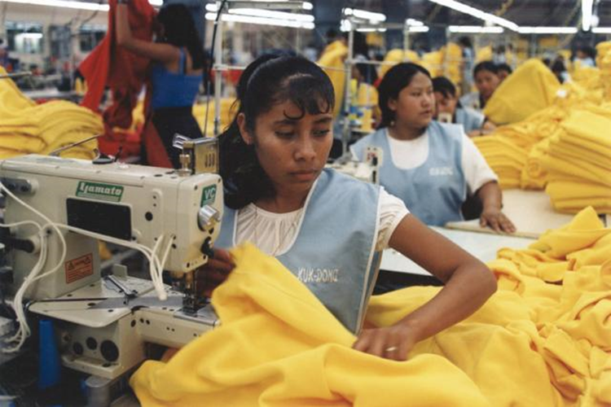
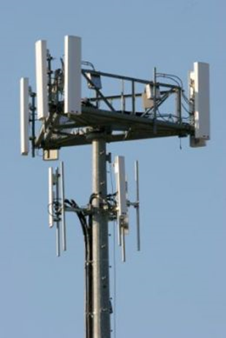
Economic Restructuring & New Metropolitan Form (1983-Present)
Since 1970s three kinds technologies were crucial to rise of Informational Economy
Production Process Technologies -Have increased the separability & Flexibility of production processes (offshoring)
Transactions Technologies –Firms can be locationally and organizationally flexible (Just-in-manufacturing)
Circulation Technologies- Reduced the time & cost of communications & distribution. Led to a wider geographic market

Slide 3
New Metropolitan Forms
Led to reorganization of US economy and the Urban
1. Transformation of relationship between corporate capital & labor. Mechanization, Offshoring, women & immigrants, decline of strength of traditional unions (End of Organized Capital)
2. New role for State & Public sector – shifted away from collective consumption (tax & spend on schools, hospitals, and community services) to public/private partnerships, deregulation, $ into high technology & DEFENSE
3. New International & Intermetropolitan Divisions of Labor Greatest proportional growth of professional & business services has occurred in midsized metro areas Boston, Washington DC, San Jose, Austin, Raleigh-Durham, Colorado Springs

Slide 4
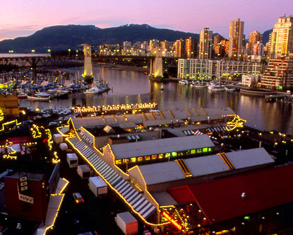
Granville Island, Vancouver, B.C.

Slide 5
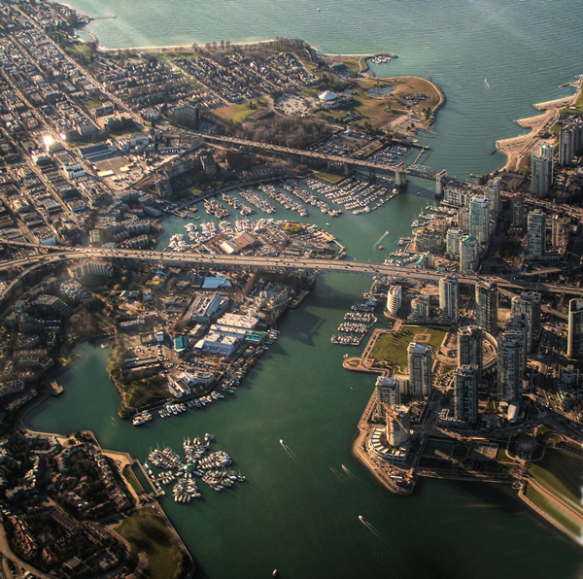
Aerial View of Granville Island

Slide 6
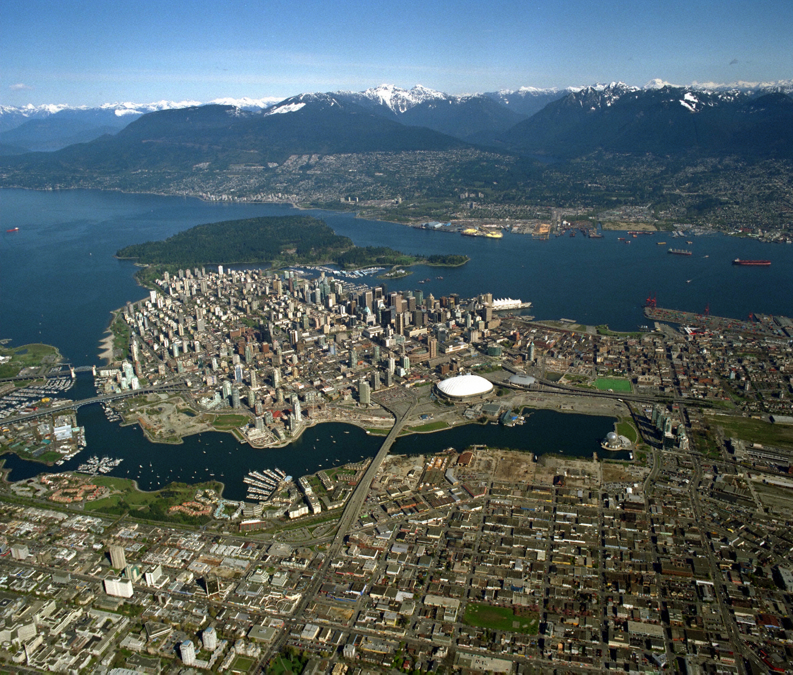

Slide 7
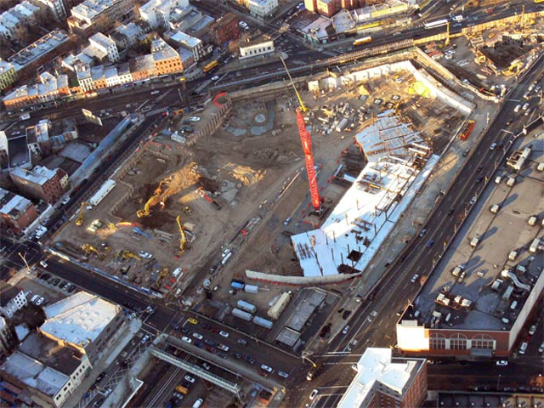
Atlantic Yards Project, Brooklyn, New York

Slide 8
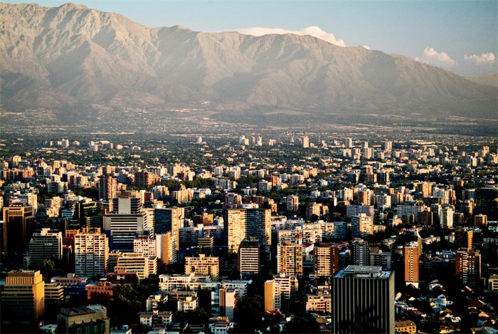
Where is this?

Slide 9
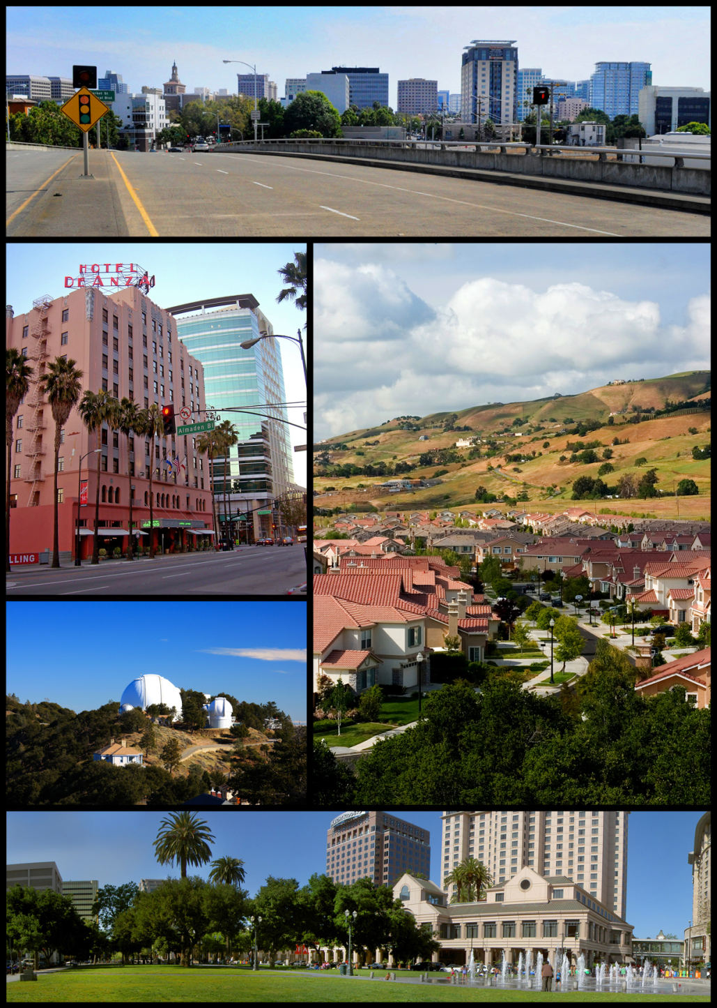

Slide 10
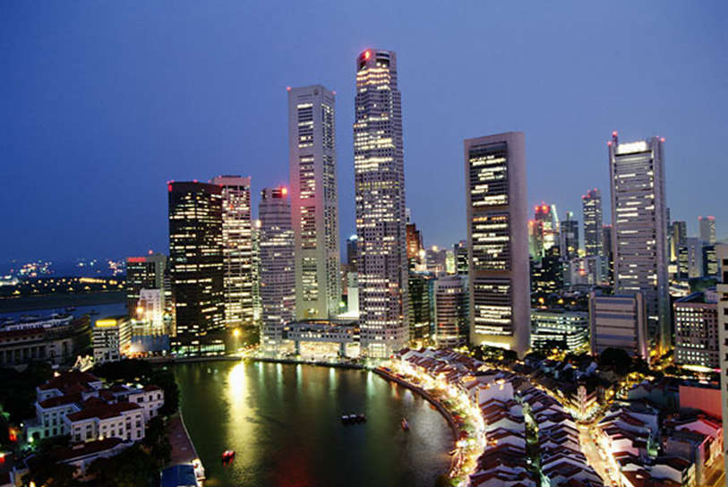
World Cities
Term developed by Patrick Geddes – Emphasizes that a few cities control a disproportionate amount of $ & business
Now expanded to express that these cities are in the center of “spaces of flows” or control points for transnational production, marketing, culture, and international finance

Slide 11
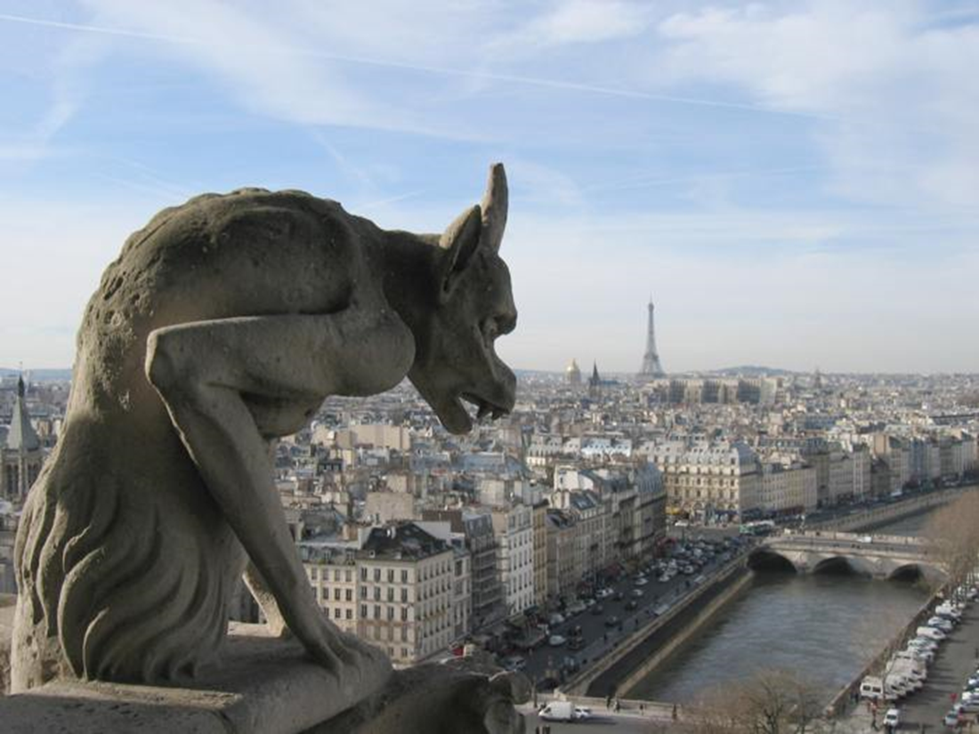
Alpha-level World Cities
Alpha ++ London and New York
Alpha + Hong Kong, Paris, Singapore, Tokyo, Sydney, Milan, Shanghai, and Beijing

Slide 12
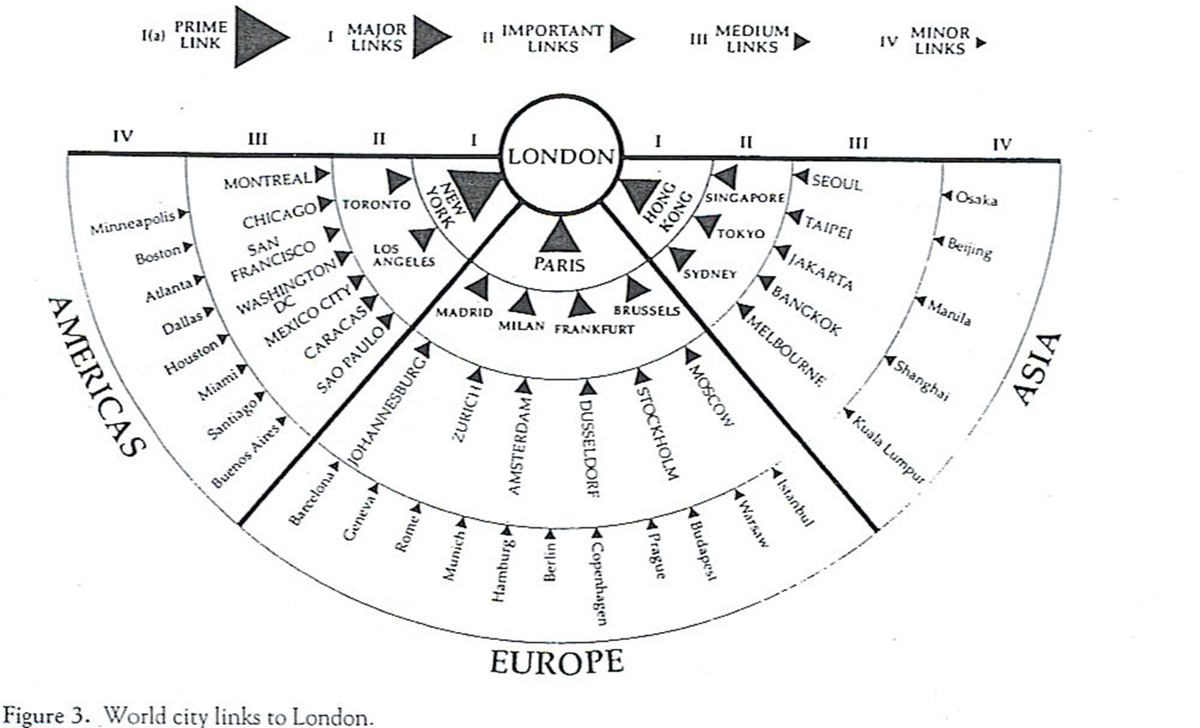
London and its Global Reach

Slide 13
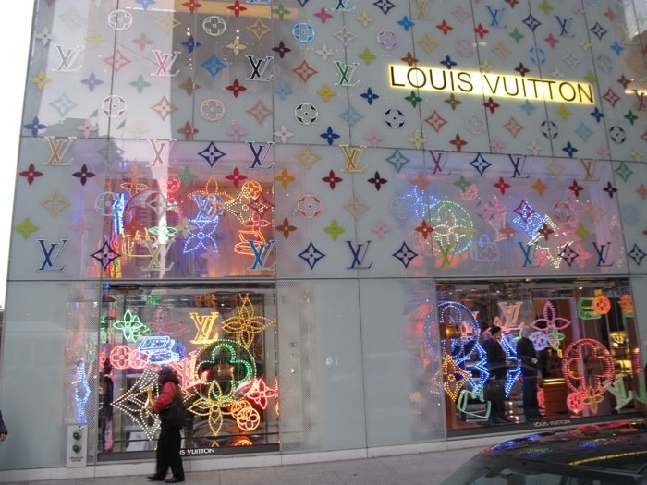
Key Distinctive Features of World Cities
Growing control over production & transmission of news, information, & culture
Comparative advantage in “Branding” of services
Economic/Social polarization-Growing international elites; inner city gentrification (upper East Side of Manhattan); large informal economy; Large and growing group of disadvantaged people (Battery Park)
Middle class is increasingly absent

Slide 14

Extremely Wealthy Returning to Inner City

Slide 15

Battery Park, Manhattan

Slide 16

Where will these Young Working Women Now Live?

Slide 17

Atlantic Yards Project, Brooklyn, NY

Slide 18
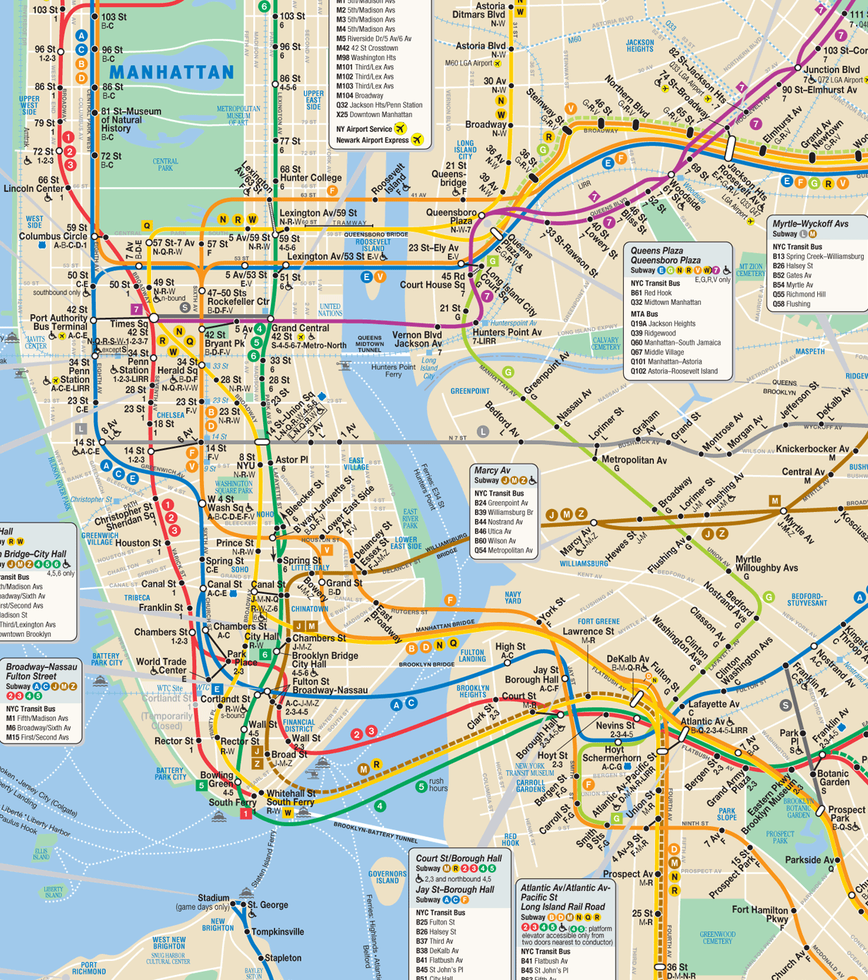

Slide 19
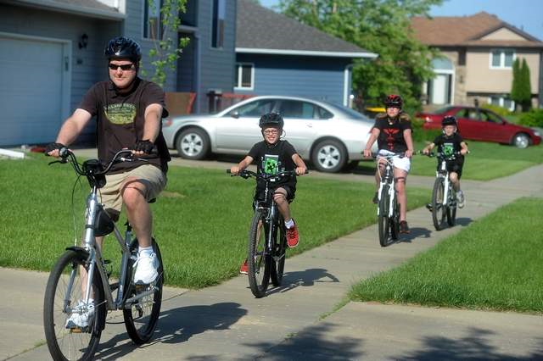
Chapter 12 – The Residential Kaleidoscope
Examines the “classic” arrangement of residential subareas in US and European cities prior to 1970s.
Examines social interaction and residential segregation – focusing on physical distance, social distance, and patterns of social interaction. Both of these attributes contribute to social interaction and residential segregation (We will examine the Chicago School’s notion of “Human Ecology”, which became the benchmark of urban theory until the mid 20th century.)

Slide 20

Chapter 12 - Introduction
Examine neighborhood differentiation in terms of residential segregation (based on social status, household type, ethnicity, and lifestyles.)
Look at new forms of social groups, household organization and new lifestyle orientations have been imprinted on the social map

