Slide 1
EE130
Electromechanics
2013
J. Arthur Wagner, Ph.D.
Prof. Emeritus in EE
wagneretal@sbcglobal.net

Slide 2
Fig. 4.11 Converter for DC motor (brush-type) drive
A fictitious node is added to create two voltages van and vbn that go positive and negative (with respect to n).

Slide 3
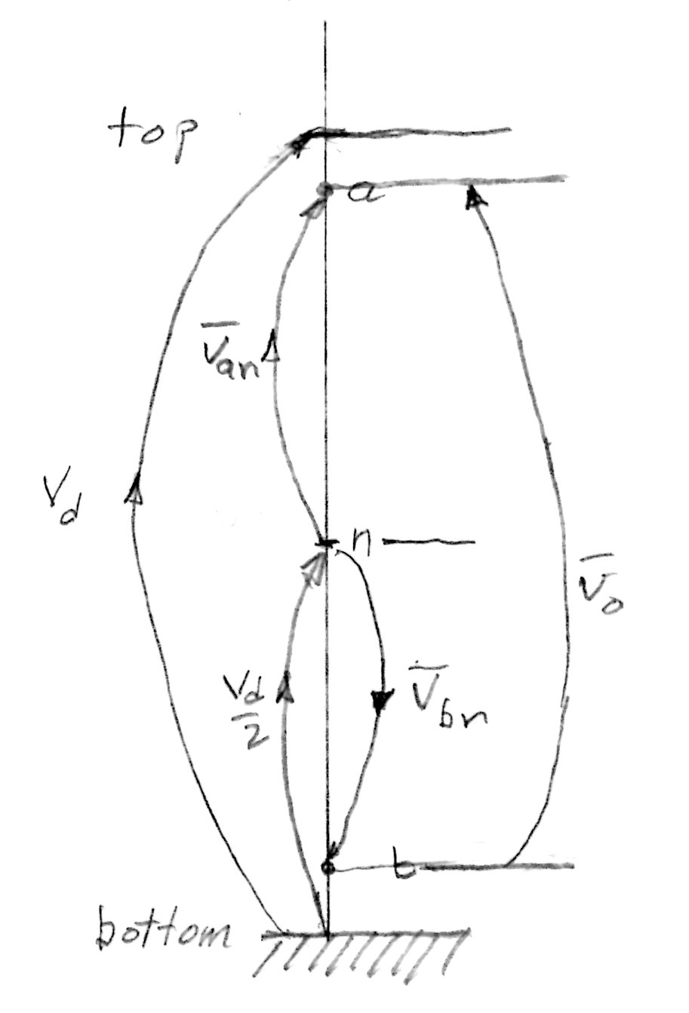
Climb a Potential Rock Wall
Potential is analogous to height.
Cannot climb higher than Vd.
Cannot go below the ground.
Climb up Vd to the top of the wall.
Climb half way down to n, at Vd/2.
Climb up van bar to a, connected to the left power pole.
Climb down to n.
Climb down to b, potential wrt to ground decreases while vbn bar increases.
Climb from b to a, the output voltage vo bar.

Slide 4
Climb a Potential Rock Wall and Switch Duty Cycles
The power pole 1 switch is more up than down to have a large van bar.
Estimate the duty cycle.
What is happening with power pole 2 switch?
The duty cycles are adjusted to present a symmetric output.

Slide 5
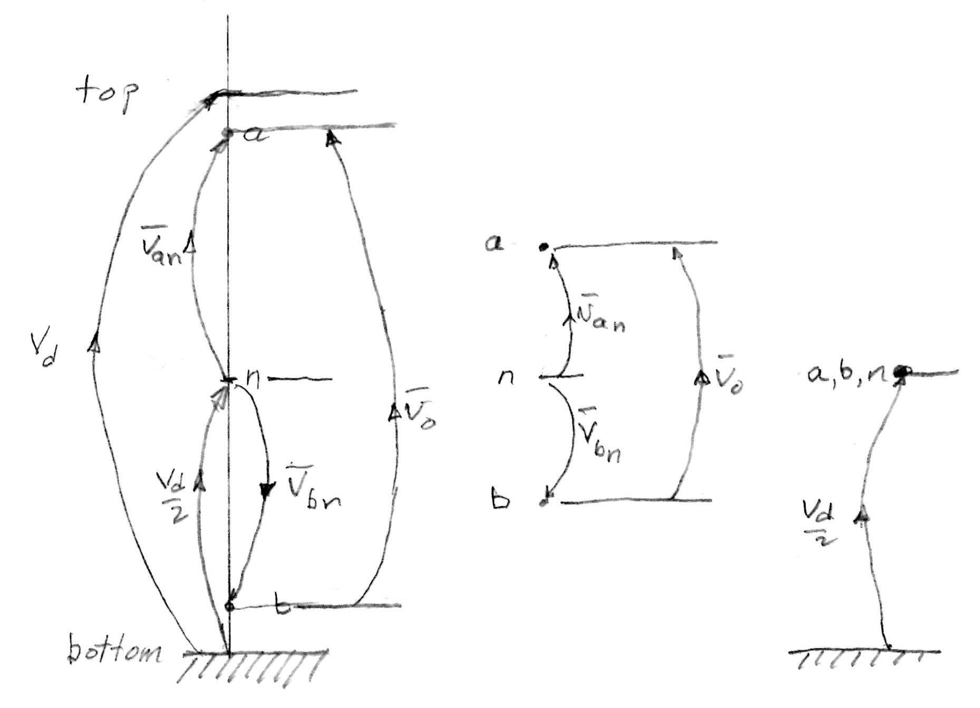
Lower point a and raise point b on the rock wall
The climb from n to a is shorter while the climb down to b is symmetric. The climb from b to a is smaller.
What are we doing to the duty ratios?
Move points a and b to n. What is vo bar? What are the duty ratios?

Slide 6
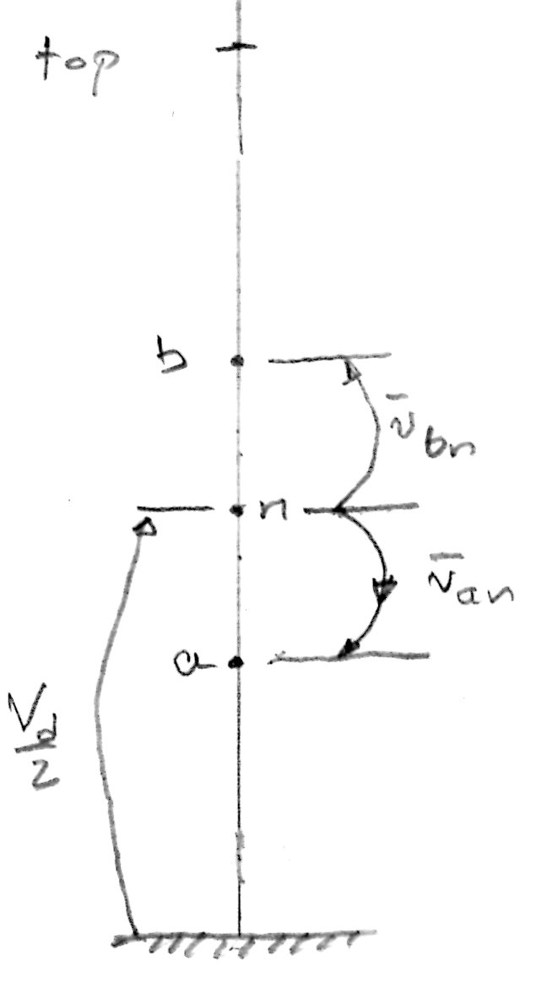
Lower point a below point b symmetrically on the rock wall
The climb from n to a is now downward, a negative change in height while the opposite is true for point b.
What are we doing to the duty ratios?

Slide 7
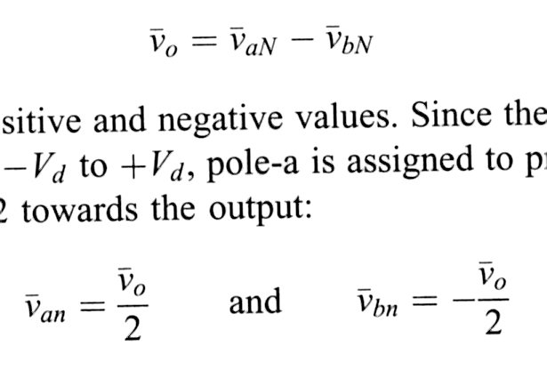
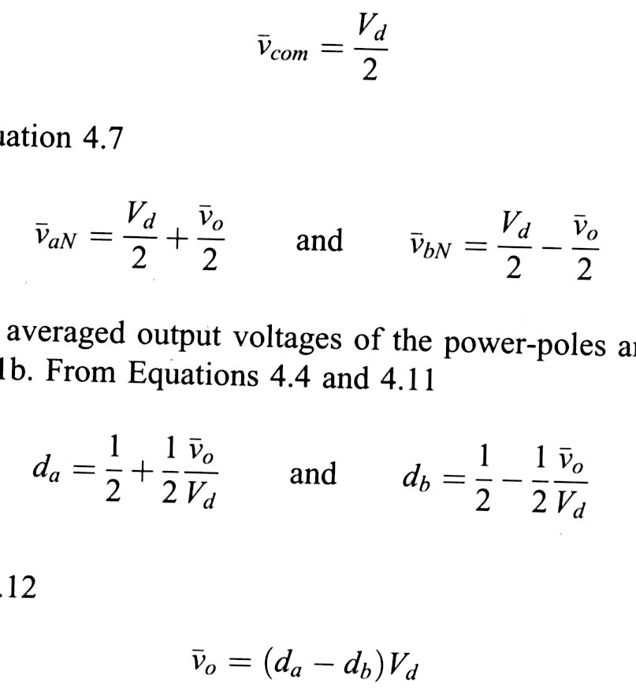
The equations
What is the difference between vaN bar and van bar?
Can da or db be negative?
Can vo bar be negative?

Slide 8
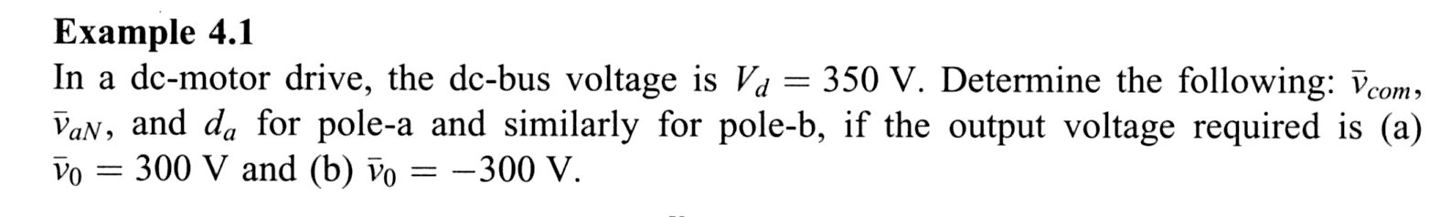
Ex. 4.1

Slide 9
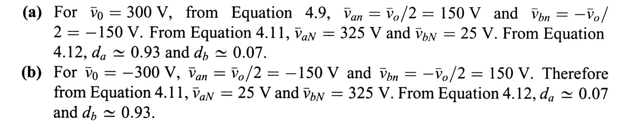
Ex. 4.1
What happened to the roles of da and db?

Slide 10
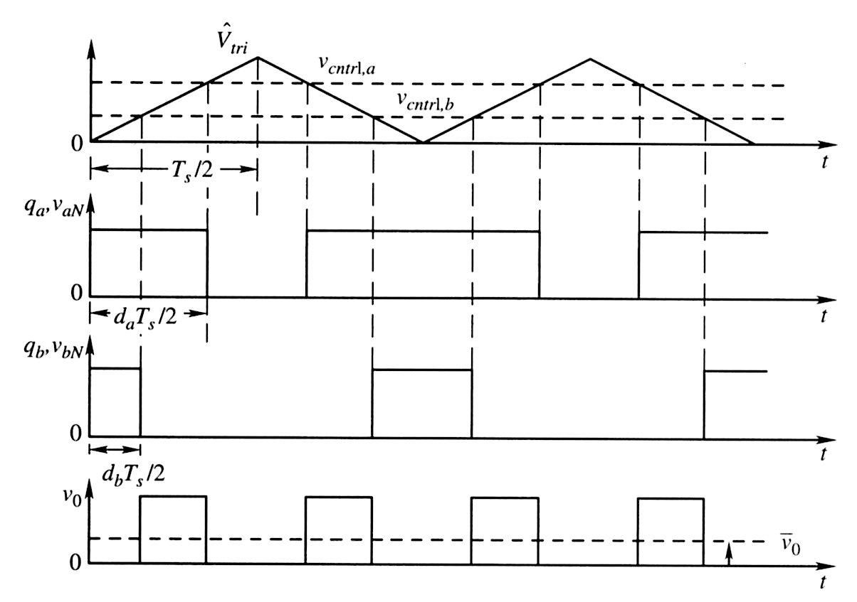
Fig. 4.14 Switching voltage waveforms
Check qa, vaN, qb, vbN during Ts/2.
Discuss how vo is formed from vaN and vbN. What is the ON time for vo?
Compare the first harmonic of vo with the first harmonic of vaN.

Slide 11
Question
Explain how vo is formed from vaN and vbN.

Slide 12
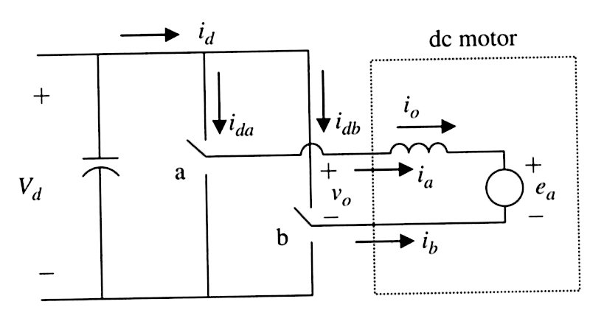
Fig. 4.15 Currents defined in the converter
We have six currents defined. io, ia, and ib continue while
id, ida, and idb can stop.

Slide 13
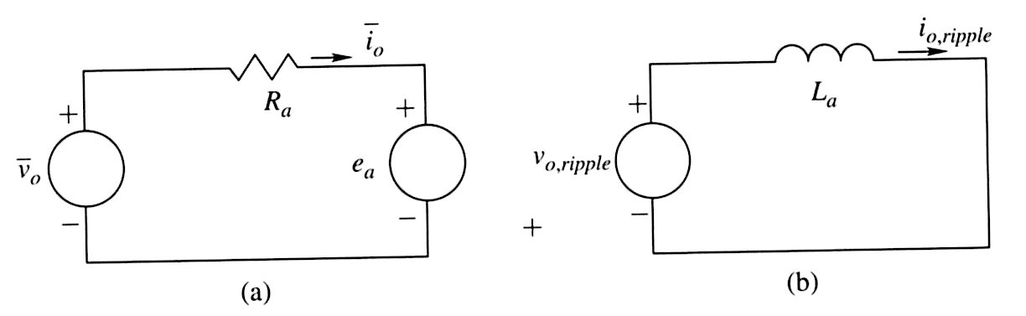
Fig. 4.16 Superposition of dc and ripple
In dc, there is no voltage drop across an inductance. The dc vo bar
is bucked (against) ea, which is virtually constant due to motor
inertia.
With ripple, the inductance voltage drop is significantly more
than the ripple drop across the resistance. There is nothing in ea
that opposes a rippling current.
Hence, we can analise separately, and then superimpose.

Slide 14
Questions
Why can we consider ea constant in our time frame as used
in the dc circuit?

Slide 15
Homework Chapter 4, Due next Tuesday
Problems 4.1, 4.2, 4.3, 4.4, 4.5, 4.6, 4.7

Slide 16
Ex. 4.3 Switching Waveforms
Vd = 350 V
ea = 236 V (dc)
io bar = 4.0 A
Ra = 0.5 ohms
Calculate vo bar (dc circuit)
vo bar = 236 V + 0.5 ohms * 4.0 A = 238 V
Would you expect da to be greater or less than 0.5?
fs = 20 kHz
Calculate Ts.

Slide 17
Ex. 4.3 Switching Waveforms
Ts = 50 us
From Equ. 4.12:
da = 0.84
db = 0.16
Assume Vtri hat = 1 V
Require io ripple = 1 A (peak to peak)
Find the inductance to meet this ripple requirement.

Slide 18
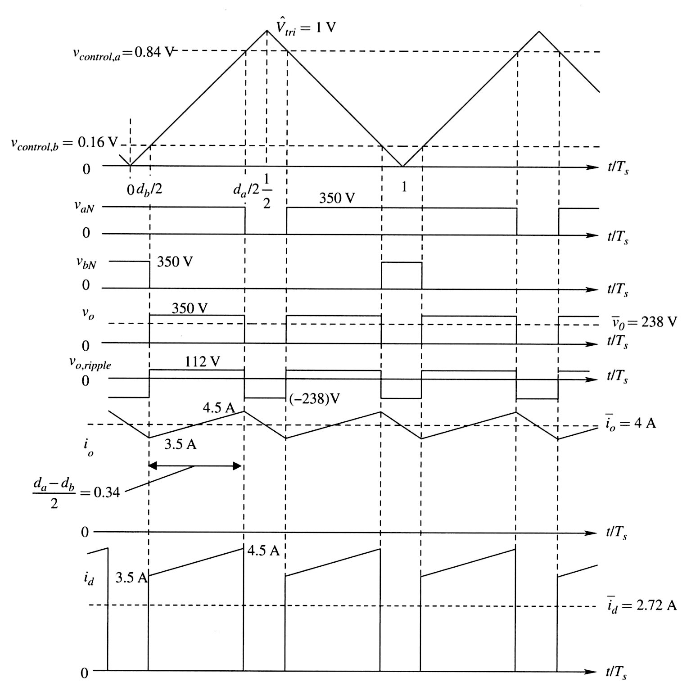
Fig. 4.17 Time normalized by Ts.
Observe 1V, 0.84V, 0.16V
Observe 350 V,
238 V.
Show ripple voltage calculation.
Note current io bar = 4 A and current ripple requirement.
Note id and 2.72 A.

Slide 19
Question
What are the conditions on the two switches for
id to flow?

