Slide 1
EE130
Electromechanics
2013
J. Arthur Wagner, Ph.D.
Prof. Emeritus in EE
wagneretal@sbcglobal.net

Slide 2
Fig. 4.1 Voltage-link system
Vd is the voltage-link, or dc-bus voltage. Vd “sits” between two AC systems.
Vd does not reverse
because transistors can
block voltage with
only one polarity.

Slide 3
Questions
Does the voltage link reverse in polarity?
Why?

Slide 4
Fig. 4.2 Switch mode converters
Discuss figures and switching
e.g. Sw a up – down – up – down …. and sw b down only
e.g. Sw a up – down – up – down … sw b and sw c down only
PPU efficiency about 95 %

Slide 5
Questions
How do you define PPU efficiency?
What is a typical value for PPU efficiency?

Slide 6
Allegro stepper motor driver
Trace power pole for one phase

Slide 7
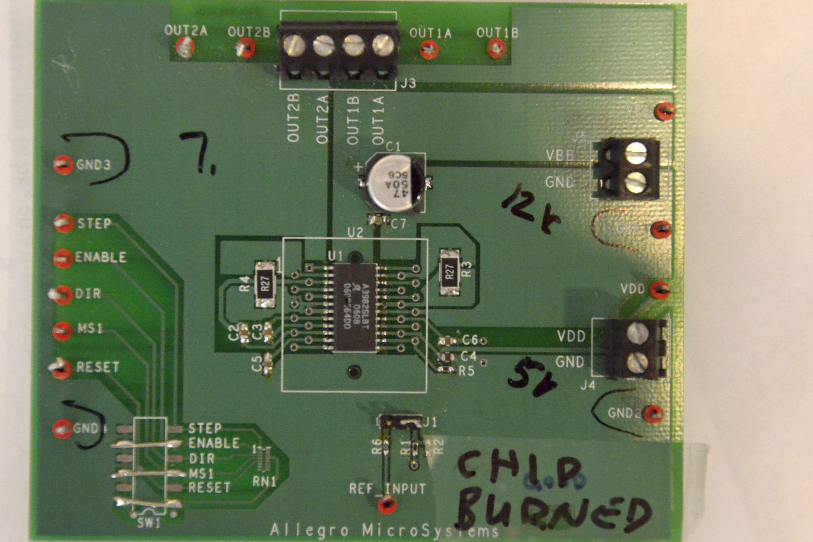
Prototype board
Driver chip
12 V power supply = bus voltage
capacitor
note large traces

Slide 8
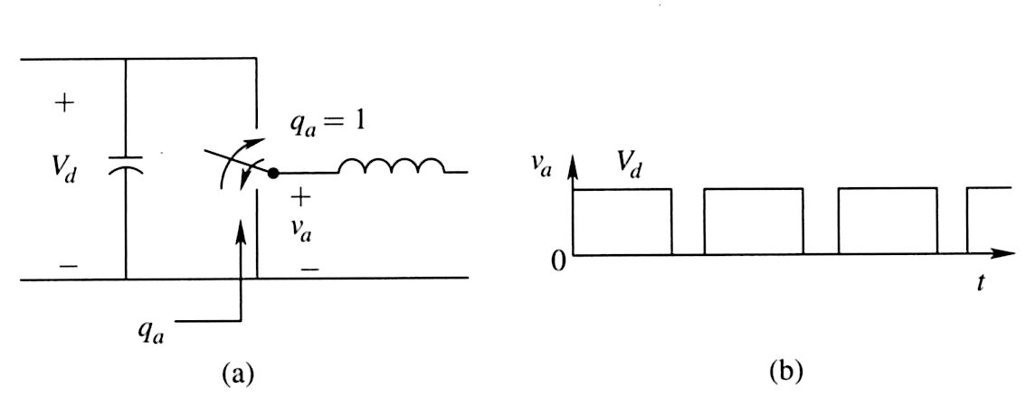
Fig. 4.3 Switching power-pole
The switch contacts up and contacts down.
Never “open” or “floating”.
qa is a logic signal.
The inductance keeps the current flowing (with some ripple).

Slide 9
Questions
What keeps the current flowing?

Slide 10
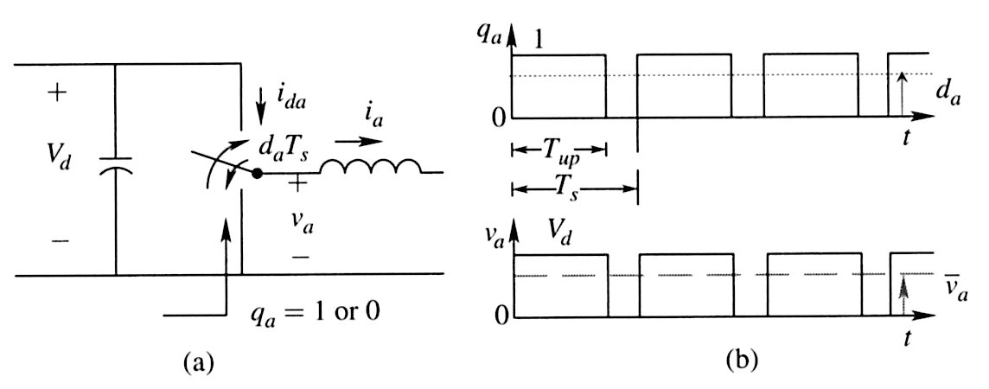
Fig. 4.4 PWM of the switching pole
The logic signal is up = 1 and down = 0.
The period Ts is fixed. Tup varies, i.e. the Pulse Width is Modulated (PWM)
Note ida stops, i.e. goes to zero, ia continues.

Slide 11
Question
Suppose Ts = 0.1 ms and Tup = 0.08 ms while Vd is
applied to the load.
What is the average voltage va?

Slide 12

Average voltage, and
“turns ratio”

Slide 13
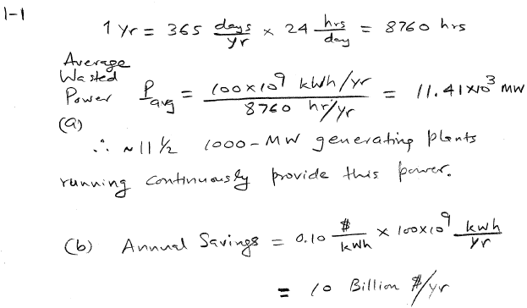
Homework Solutions 1-1

Slide 14
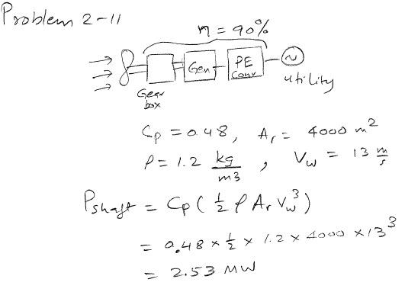
Homework Solutions 2-11

Slide 15
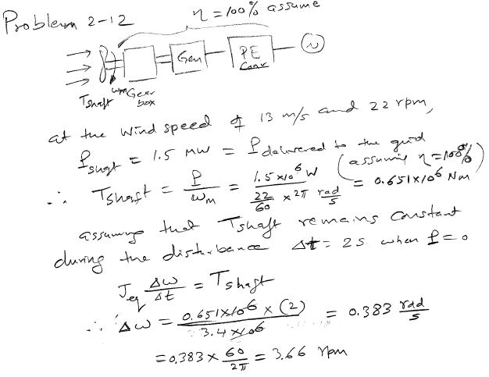
Homework Solutions 2-12

Slide 16
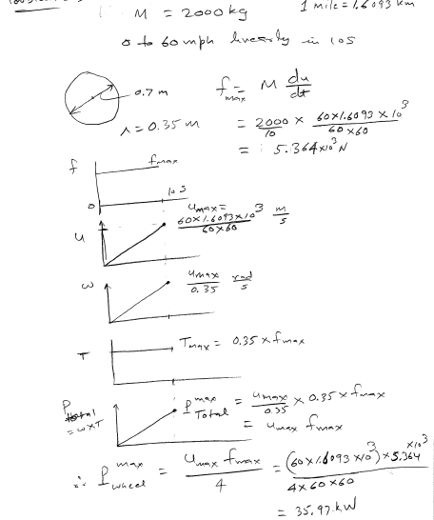
Homework Solutions 2-13

Slide 17
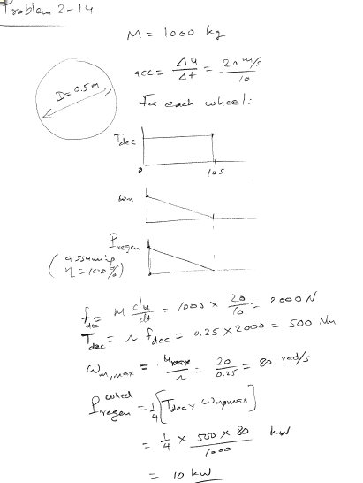
Homework Solutions 2-14

Slide 18
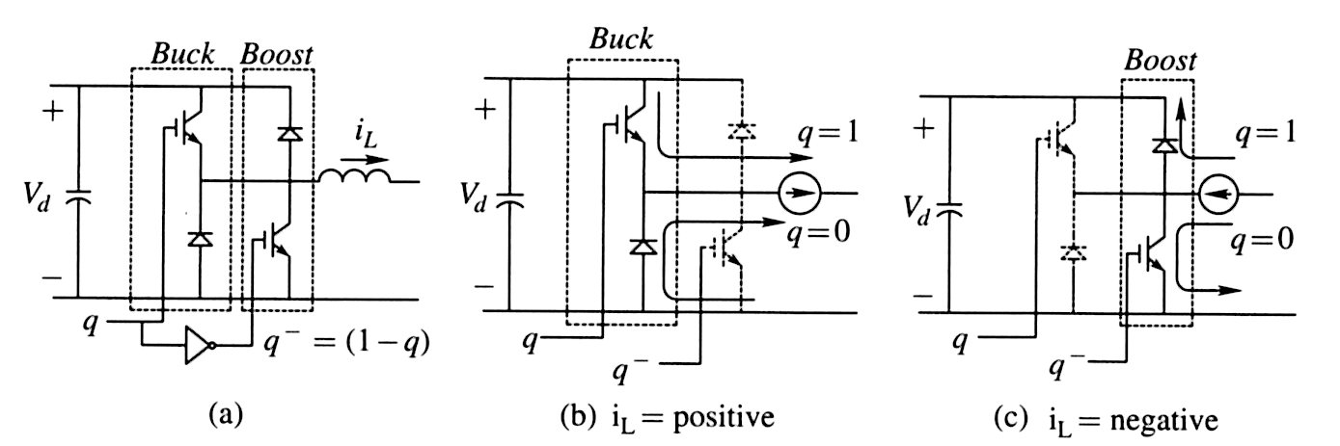
Fig. 4.5 Bi-directional power flow
a FET sets a current direction, diode continues the flow.
q turns one FET ON, and other FET OFF
a bemf in the motor “bucks” (is against) Vd
current flows into Vd and “boosts” its voltage

Slide 19
Question
Name a situation where the boost function is used.

Slide 20
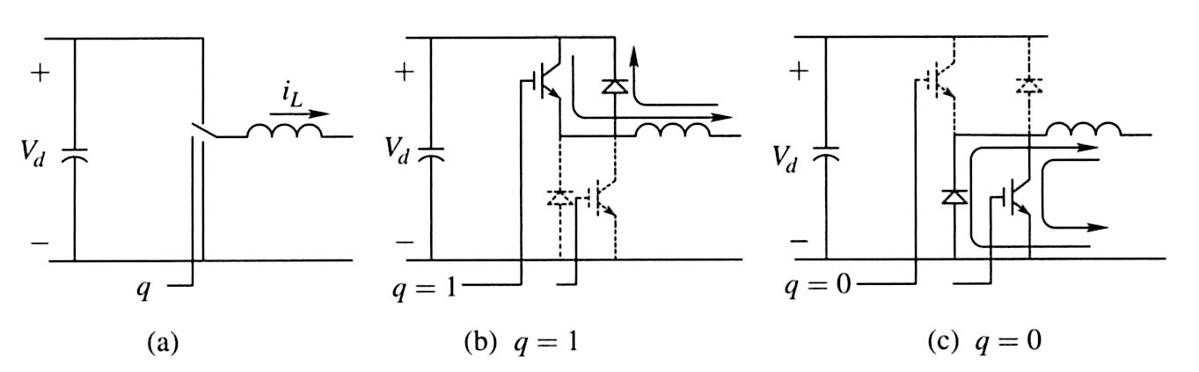
Fig. 4.6 Bidirectional switching power pole
The left FET and diode operate together when the current is
flowing out.
Question: Tell me how the right diode and FET operate together.

Slide 21
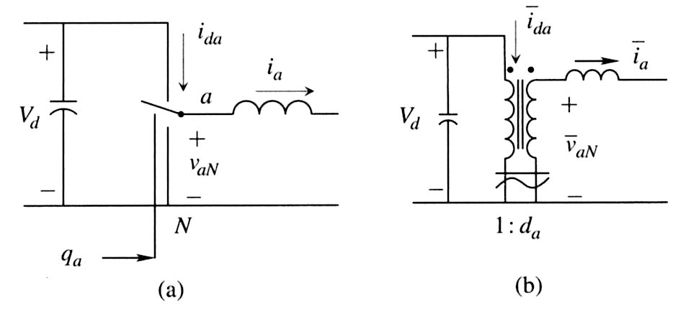

Fig. 4.7 Switching-cycle average
Now .
always flows and
stops flowing
This transformer steps down the voltage and steps up the current.

Slide 22
Question
Explain this statement:
always flows and
stops flowing

Slide 23
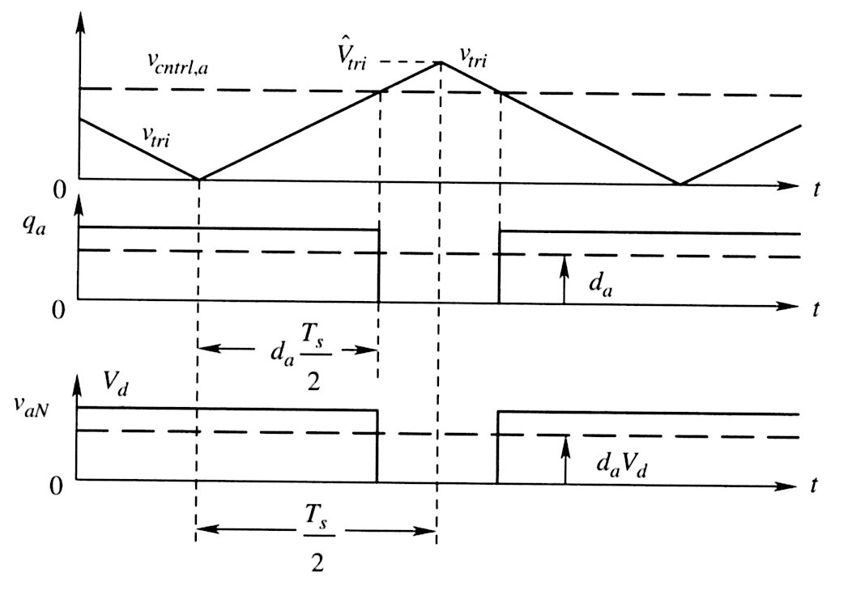
Fig. 4.8 PWM Waveforms in a switching power pole
Point out 1 cycle and one ½ cycle.
When vtri < vcntrl,a we have an UP, otherwise a DOWN.

Slide 24
Question
How does vcntrl,a vary with respect to vtri?

Slide 25
Fig. 4.9 Switching power-pole and its duty-ratio control
We add onto the drawing the model which generates the switching signal qa
(Incidentally, we show variables as time functions.)

Slide 26
Question
With respect to vcntrl,a and vtri,
when is qa UP and when is qa DOWN?

Slide 27
Homework Chapter 4, Due next Tuesday
Problems 4.1, 4.2, 4.3, 4.4

