Slide 1
Implementing PID on a microcontroller
BJ Furman
ME 190 Mechatronics Engineering Design
11NOV2015
(adapted from: http://brettbeauregard.com/blog/2011/04/improving-the-beginners-pid-introduction/)

Slide 2



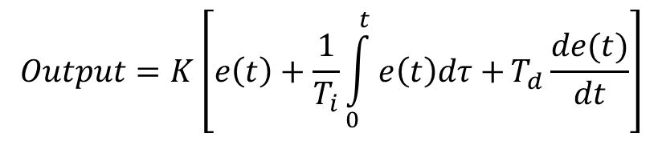


PID equation
Figure from Matlab Help (Designing PID Controllers with the PID Tuner)
Parallel form
u=
= r(t) – y(t)
Standard form
let
$$K_{p}=K$$
$$K_{i}=\frac{K}{T_{i}}$$
$$K_{d}={KT}_{d}$$
$$Output=K\left[e\left(t\right)+\frac{1}{T_{i}}\int_{0}^{t}{e\left(t\right)dτ+}T_{d}\frac{de(t)}{dt}\right]$$
u=

Slide 3
Important considerations
Sample Time
Derivative Kick
On-The-Fly Tuning Changes
Reset Windup Mitigation
On/Off (Auto/Manual)
Initialization (bump-less transfer)
Controller Direction

Slide 4
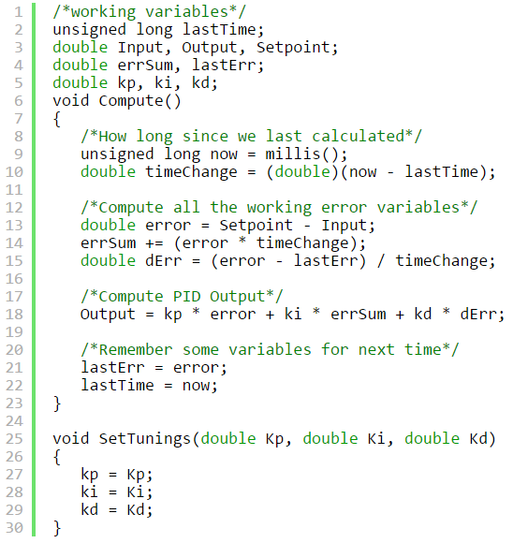
(Way too) simple algorithm
Notes:
This one is designed to be called aperiodically, hence on lines 9-10, the time change is calculated from when it was last called.

Slide 5
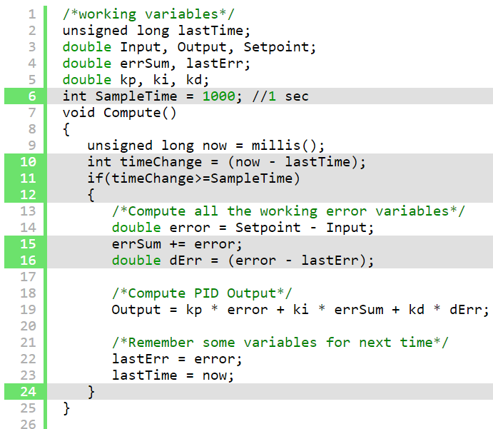
Sample Time
Need to call at a regular interval
  Use millis() or an interrupt
(cont.)→
Notes:
On lines 10&11, the algorithm now decides for itself if it’s time to calculate. Also, because we now KNOW that it’s going to be the same time between samples, we don’t need to constantly multiply by time change. We can merely adjust the Ki and Kd appropriately (lines 31 & 32) and result is mathematically equivalent, but more efficient.

Slide 6
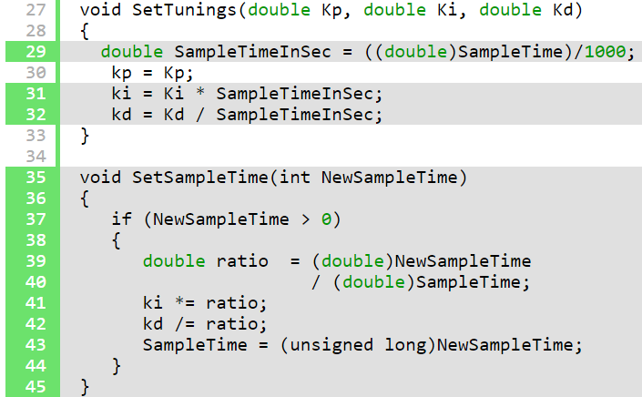
Sample Time, cont.
Notes:
On lines 10&11, the algorithm now decides for itself if it’s time to calculate. Also, because we now KNOW that it’s going to be the same time between samples, we don’t need to constantly multiply by time change. We can merely adjust the Ki and Kd appropriately (lines 31 & 32) and result is mathematically equivalent, but more efficient.
One little wrinkle with doing it this way though. If the user decides to change the sample time during operation, the Ki and Kd will need to be re-tweaked to reflect this new change. that’s what lines 39-42 are all about.
Also Note that I convert the sample time to Seconds on line 29. Strictly speaking this isn’t necessary, but allows the user to enter Ki and Kd in units of 1/sec and s, rather than 1/mS and mS.
The changes above do 3 things for us:
Regardless of how frequently Compute() is called, the PID algorithm will be evaluated at a regular interval [Line 11]
Because of the time subtraction [Line 10] there will be no issues when millis() wraps back to 0. That only happens every 55 days, but we’re going for bulletproof remember?
We don’t need to multiply and divide by the timechange anymore. Since it’s a constant we’re able to move it from the compute code [lines 15+16] and lump it in with the tuning constants [lines 31+32]. Mathematically it works out the same, but it saves a multiplication and a division every time the PID is evaluated.
If this PID is going into a microcontroller, a very good argument can be made for using an interrupt. SetSampleTime sets the interrupt frequency, then Compute gets called when it’s time. There would be no need, in that case, for lines 9-12, 22, and 23.

Slide 7
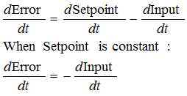
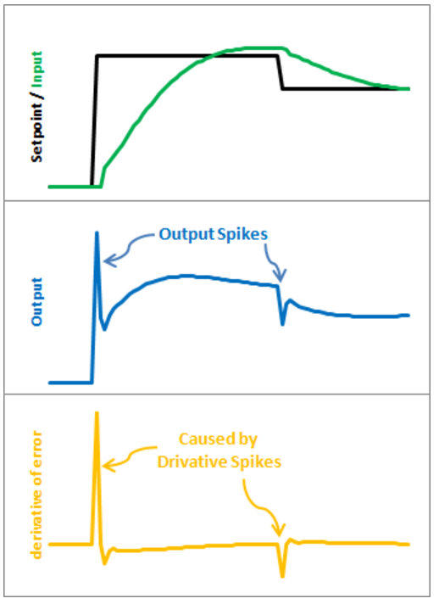
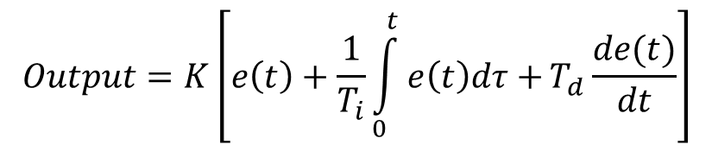
Derivative Kick
The problem
$$Output=K\left[e\left(t\right)+\frac{1}{T_{i}}\int_{0}^{t}{e\left(t\right)dτ+}T_{d}\frac{de(t)}{dt}\right]$$
Derivative Spikes
Notes:
Instead of adding (Kd * derivative of Error), we subtract (Kd * derivative of Input). This is known as using “Derivative on Measurement”. The modifications here are pretty easy. We’re replacing +dError with -dInput. Instead of remembering the lastError, we now remember the lastInput

Slide 8
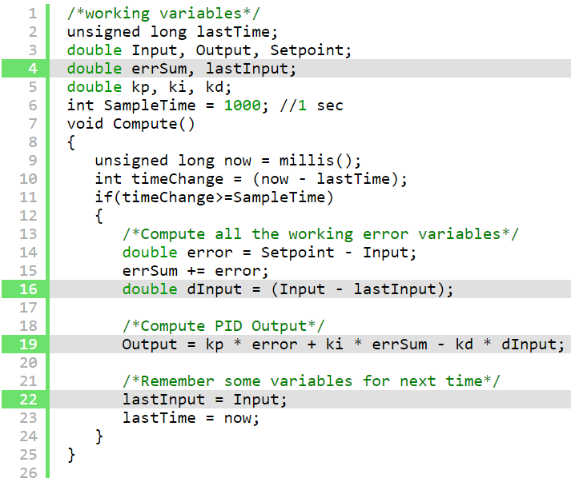
Derivative Kick, cont.

Slide 9
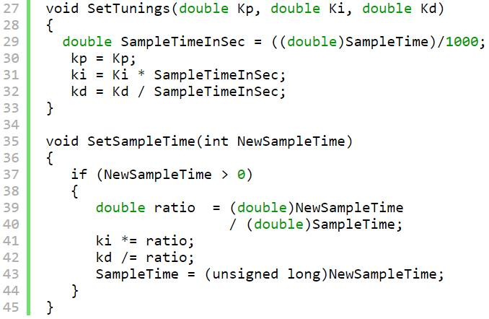
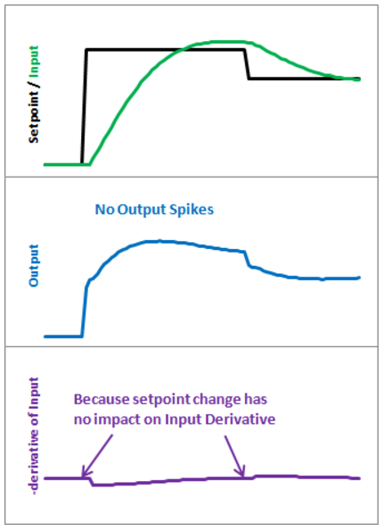
Derivative Kick, cont.

Slide 10
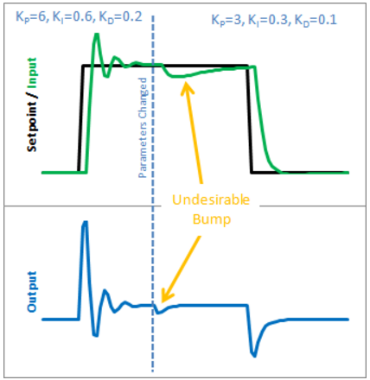
On-the-fly tuning changes
When things go ‘bump’…
Notes:
Note the change in Ki (from 0.6 to 0.3). The algorithm heretofore was multiplying ki times the accumulated error. If Ki changes, all of a sudden, the contribution from the integral term jumps (bump). The solution is to calculate the contribution of the integral term differently.

Slide 11

On-the-fly tuning changes, cont.
Calculate the contribution for the integral term differently:
  Before
  After
Notes:
Note the change in Ki (from 0.6 to 0.3). The algorithm heretofore was multiplying Ki times the accumulated error. If Ki changes, all of a sudden, the contribution from the integral term jumps (bump). The solution is to calculate the contribution of the integral term differently. Accumulate the sum of the error multiplied by the current Ki.

Slide 12
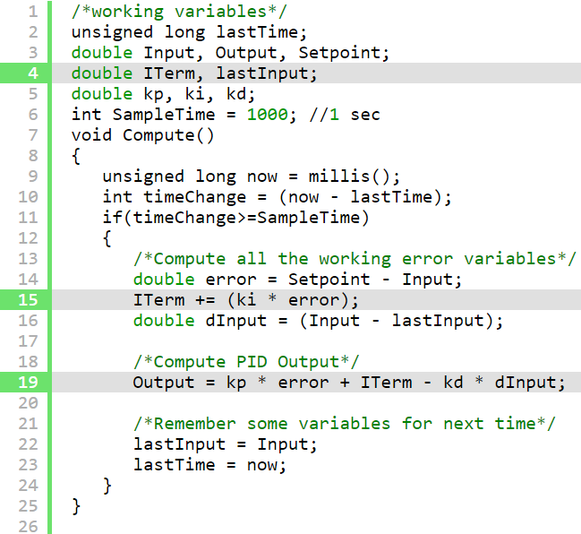
On-the-fly tuning changes, cont.
Notes:
So we replaced the errSum variable with a composite ITerm variable [Line 4]. It sums Ki*error, rather than just error [Line 15]. Also, because Ki is now buried in ITerm, it’s removed from the main PID calculation [Line 19]. With this code, the previous error remains untouched, and the new ki only affects things moving forward, which is exactly what we want.

Slide 13
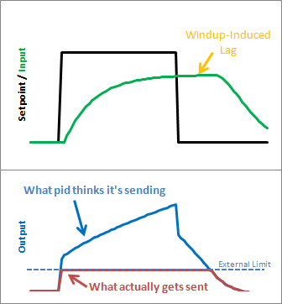
Integrator windup
The problem
Notes:
If the controller reaches its limit in terms of what it can output, if you don’t handle this by doing something like clamping the integrator output, the integral control part of the output signal will, ‘wind up’ and accumulate a large value. If the set point drops, it will take a long time to de-accumlate the integrated error component.

Slide 14
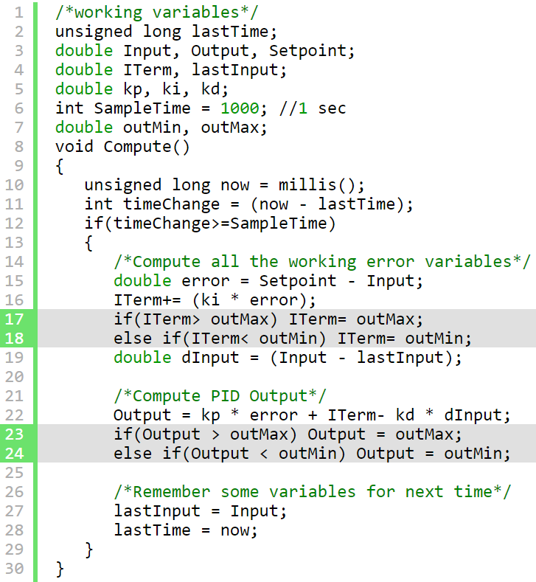
Integrator windup, cont.
Notes:
Clamp both the integrator output and the proportional + derivative output.

Slide 15
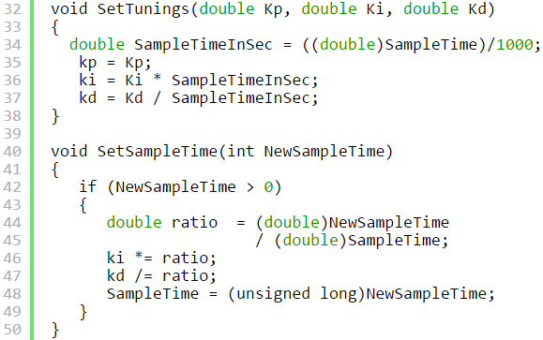
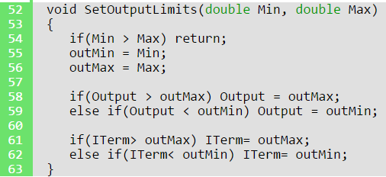
Integrator windup, cont.
(same as before)
Notes:
Clamp both the integrator output and the proportional + derivative output. A new function was added to allow the user to specify the output limits [lines 52-63]. And these limits are used to clamp both the I-Term [17-18] and the Output [23-24]

Slide 16
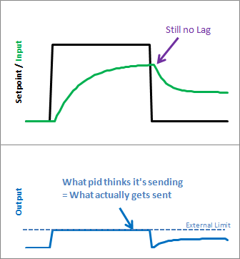
Integrator windup, cont.
The result
Notes:
Clamp both the integrator output and the proportional + derivative output. As we can see, windup is eliminated. in addition, the output stays where we want it to. this means there’s no need for external clamping of the output. if you want it to range from 23 to 167, you can set those as the Output Limits.

Slide 17
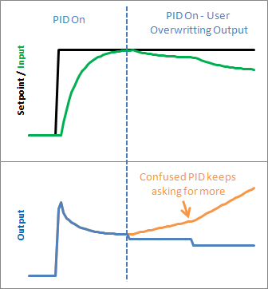
On/Off (automatic or ‘manual’)
The problem
Notes:
Let’s say at some point in your program you want to force the output to a certain value (0 for example) you could certainly do this in the calling routine:
void loop()
{
Compute();
Output=0;
}
This way, no matter what the PID says, you just overwrite its value. This is a terrible idea in practice however. The PID will become very confused: “I keep moving the output, and nothing’s happening! What gives?! Let me move it some more.” As a result, when you stop over-writing the output and switch back to the PID, you will likely get a huge and immediate change in the output value.

Slide 18
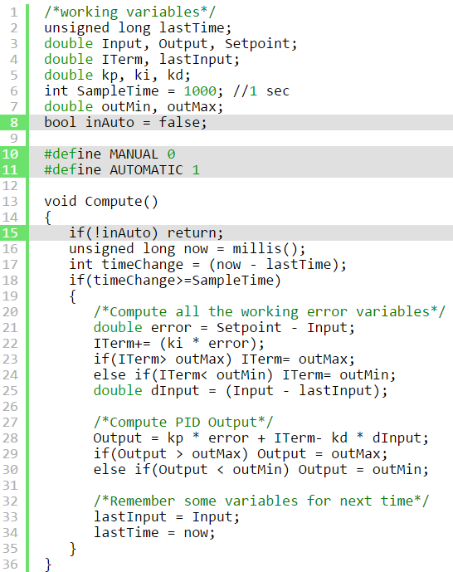
On/Off, cont.
Notes:
The solution to this problem is to have a means to turn the PID off and on. The common terms for these states are “Manual” (I will adjust the value by hand) and “Automatic” (the PID will automatically adjust the output). Do this by checking if you should be in ‘manual’ (off) or ‘automatic’ (on) mode. If NOT in auto mode, then jump out of the function that re-calculates the controller output (just leave it as it was).

Slide 19
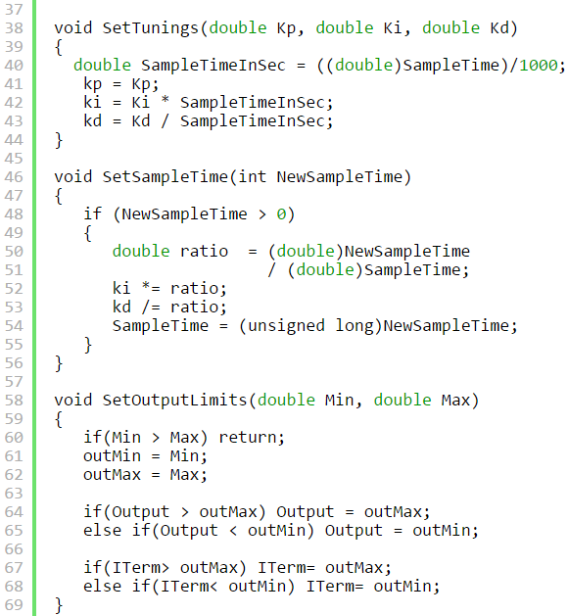

On/Off, cont.
(same as before)
Notes:
The solution to this problem is to have a means to turn the PID off and on. The common terms for these states are “Manual” (I will adjust the value by hand) and “Automatic” (the PID will automatically adjust the output). Do this by checking if you should be in ‘manual’ (off) or ‘automatic’ (on) mode. If NOT in auto mode, then jump out of the function that re-calculates the controller output (just leave it as it was).

Slide 20
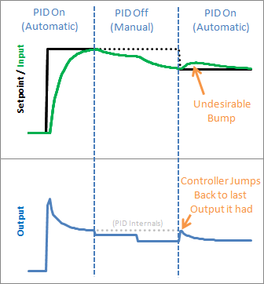
Initialization
The problem
Notes:
Going from auto to manual and back to auto the PID controller output jumps back to the last Output value it sent, then starts adjusting from there. This results in an Input bump that we’d rather not have.

Slide 21
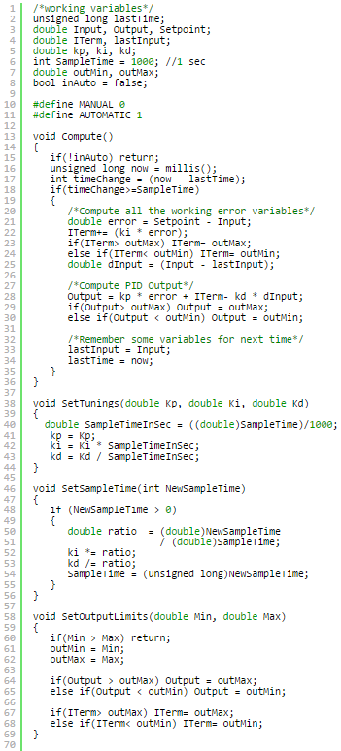
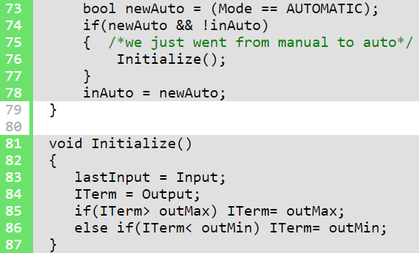
Initialization, cont.
(same as before)
Notes:
This one is pretty easy to fix. Since we now know when we’re turning on (going from Manual to Automatic,) we just have to initialize things for a smooth transition. That means massaging the 2 stored working variables (ITerm & lastInput) to keep the output from jumping.

Slide 22
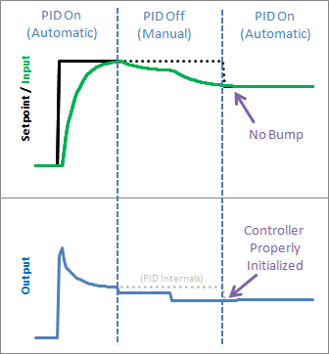
Initialization, cont.
‘Bumpless’ transfer
Notes:
We see from the above graph that proper initialization results in a bumpless transfer from manual to automatic: exactly what we were after.

Slide 23
Direction
The problem: should an increase in y (the output) lead to an increase or a decrease in the manipulating variable (u, the output of the controller)?
  Direct acting (Kp, Ki, Kd should be positive)
  Reverse acting (Kp, Ki, Kd should be negative)

Slide 24
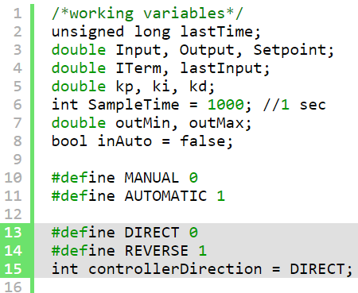
Direction, cont.
Notes:
Keep Kp, Ki, Kd all positive, but allow the user the choice to specify ‘direct’ or ‘reverse’

Slide 25
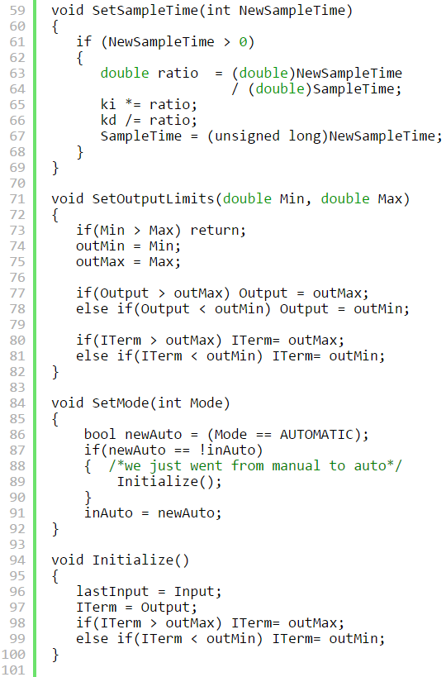
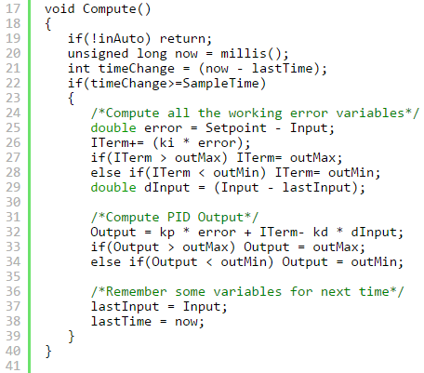

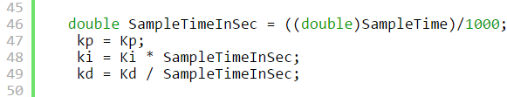

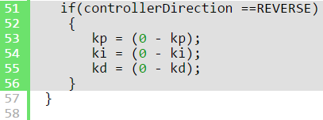
Direction, cont.
(same as before)
Notes:
Keep Kp, Ki, Kd all positive, but allow the user the choice to specify ‘direct’ or ‘reverse’

