Slide 1
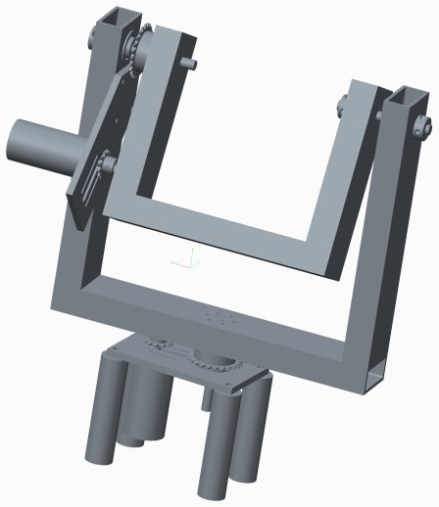
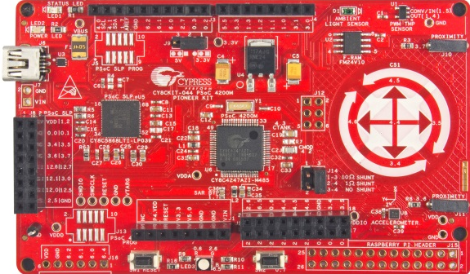
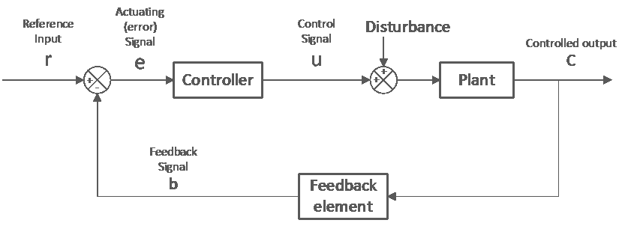
ME 190 Mechatronic Systems Design
BJ Furman
19AUG2015
http://www.cypress.com/sites/default/files/media-embed/263821/E1011653.jpg

Slide 2
Outline
Roll call
Learning objectives
Syllabus, Canvas, and ME 190 website
Course overview
Research paper assignment
Term project
Lab
Recap mechatronic systems
Open and closed loop systems

Slide 3
Learning objectives
Explain what mechatronics is all about
Explain what ME 190 is about and where it fits in the mechatronics curriculum
Describe what a system is in the context of the class
Distinguish between open and closed loop systems

Slide 4
Roll Call
Let me know the name you would like to be called

Slide 5
Syllabus and course overview
See the handout (also available on Canvas)

Slide 6
Project
See the handout: “ME 190 - Term Project Information”
A more complete mechatronic system with closed loop control
Wide open
Special emphasis and support for:
  ME 190 laboratory experiment development
    Examples (see Prof. Furman for more!)
      Azimuth-elevation positioning device
      DC motor parameter measurement and control
      PSoC
      SmartMotor
  ME 285 laboratory experiment development

Slide 7
Lab
Starts on Thursday!
Read the lab guide
  See Canvas Assignments

Slide 8
Homework
See Canvas for HW 1

Slide 9
What is mechatronics all about?
User
Interface
ME 106
ME 120
Power
Source
Controller
(Hardware & Software)
ME 30
ME 106
ME 190
ME 187
ME 106
Power
Interface
INTEGRATION
Signal
Conditioning
ME 106
ME 120
ME 106
ME 154
ME 157
ME 195
Actuator
Sensor
ME 120
ME 284
System to
Control
ME 110
ME 136
ME 154
ME 157
ME 190
ME 182
ME 189
ME 195
BJ Furman 22JAN2011

Slide 10
Open and closed loop systems
What is a system?
What is a control system?
Input
Output
System (plant)
Open loop control system
  Examples
    Dishwasher (with simple timer)
    Constant accelerator pedal angle to control speed in a car
Closed loop control system
  Examples
    Smart dishwasher from ME 106
    Cruise control

Slide 11
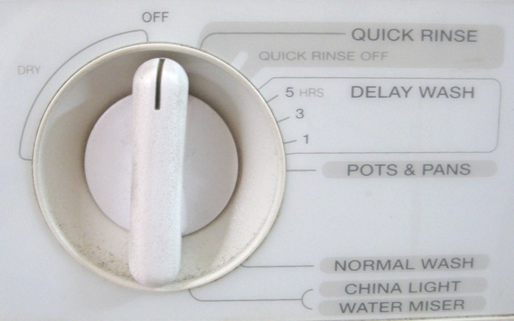
Open loop system example - dishwasher
The standard dishwasher

Slide 12
Automobile speed control – constant pedal

Slide 13
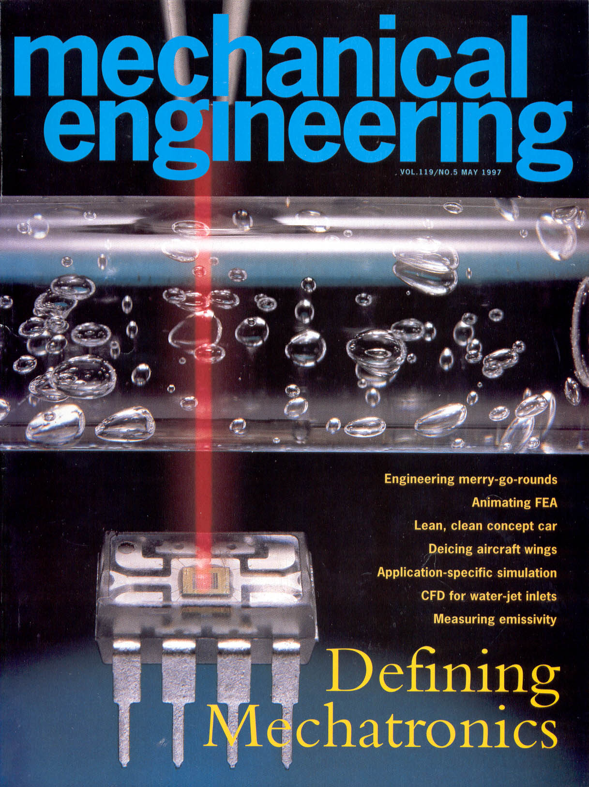
Dishwasher – closed loop

Slide 14
Closed-Loop System Block Diagram

Slide 15
Matlab
Publish feature

Slide 16
For More Information
http://www.engr.sjsu.edu/bjfurman/courses/ME190/
http://www.mathworks.com/academia/student_center/tutorials/index.html?s_tid=acmain_lrn_tut

