Slide 1

Chapter 6
Fact-Finding Techniques for Requirements Discovery

Slide 2
Objectives
Define system requirements and differentiate between functional and nonfunctional requirements.
Understand the activity of problem analysis and be able to create an Ishikawa (fishbone) diagram.
Understand the concept of requirements management.
Identify and characterize seven fact-finding techniques.
Understand six guidelines for effective listening.
Understand body language and proxemics.
Characterize the typical participants in a JRP session.
Complete the planning process for a JRP session.
Describe benefits of JRP as fact-finding technique.
Describe a fact-finding strategy that will make the most of your time with end-users.
Notes:
Chapter 6 objectives.

Slide 3
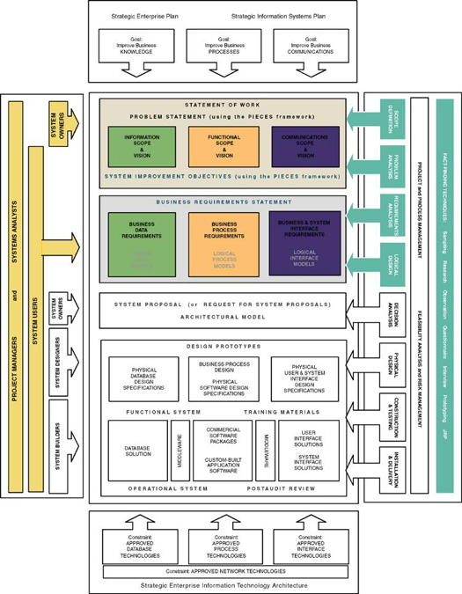
Notes:
Teaching Notes
This slide shows the how this chapter's content fits with the building blocks framework used throughout the textbook. Requirements Discovery is used throughout all the early phases; touches on knowledge, processes, and communications; and involves system owners, system users, and systems analysts.

Slide 4
Introduction to Requirements Discovery
Requirements discovery – the process and techniques used by systems analysts to identify or extract system problems and solution requirements from the user community.
System requirement – something that the information system must do or a property that it must have. Also called a business requirement.
Notes:
Teaching Notes
This chapter focuses on the techniques and activities for eliciting system requirements as well as how to properly validate and document requirements. The authors have placed an emphasis on this chapter because recent studies have shown that as many as 80% of all system development failures can be traced back to problems with requirements.

Slide 5
Functional vs. Nonfunctional Requirements
Functional requirement - something the information system must do
Nonfunctional requirement - a property or quality the system must have
  Performance
  Security
  Costs
Notes:
Conversion Notes
This slide is new in the seventh edition. The difference between functional and nonfunctional requirements is also covered in Chapter 5 but is repeated here because some instructors skip Chapter 5.

Slide 6
Results of Incorrect Requirements
The system may cost more than projected.
The system may be delivered later than promised.
The system may not meet the users’ expectations and they may not to use it.
Once in production, costs of maintaining and enhancing system may be excessively high.
The system may be unreliable and prone to errors and downtime.
Reputation of IT staff is tarnished as failure will be perceived as a mistake by the team.
Notes:
Teaching Notes
This slide (and the next) emphasize the importance of spending time in defining system requirements.

Slide 7
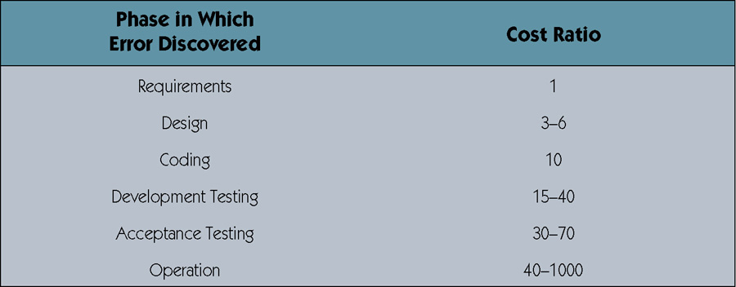
Relative Cost to Fix an Error
Notes:
Teaching Notes
Table based on work by Barry W. Boehm, a noted expert in information technology economics. Based on these findings, an erroneous requirement that goes undetected and unfixed until the operation phase may cost 1,000 times more than if it were detected and fixed in the requirements phase!

Slide 8
Criteria for System Requirements
Consistent – not conflicting or ambiguous.
Complete – describe all possible system inputs and responses.
Feasible – can be satisfied based on the available resources and constraints.
Required – truly needed and fulfill the purpose of the system.
Accurate – stated correctly.
Traceable – directly map to functions and features of system.
Verifiable – defined so can be demonstrated during testing.
Notes:
Teaching Notes
Requirements rarely initially emerge in a form that meets these criteria. Requirements discovery is an iterative process that involves refining and revising the requirements until they are correct.

Slide 9
Process of Requirements Discovery
Problem discovery and analysis
Requirements discovery
Documenting and analyzing requirements
Requirements management
Notes:
Teaching notes
The process of requirements discovery consists of four activities.

Slide 10
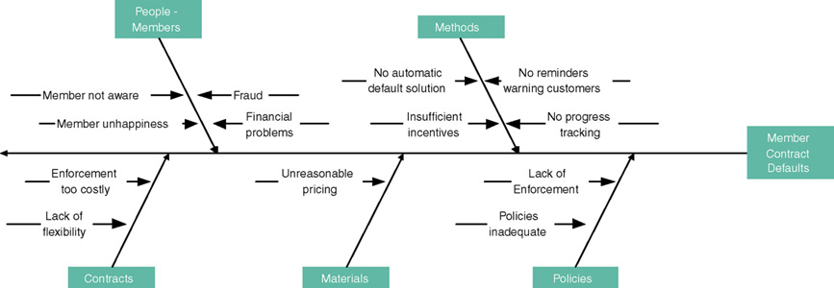
Ishikawa Diagram
Graphical tool used to identify, explore, and depict problems and the causes and effects of those problems. It is often referred to as a cause-and-effect diagram or a fishbone diagram.
  Problem at right (fish head)
  Possible causes drawn as "bones" off main backbone
  Brainstorm for 3-6 main categories of possible causes
Notes:
Teaching Notes
Explain concept to students.
The name of the problem goes at the right of the diagram (the fish’s head).
The possible causes of the problem are drawn as bones off the main backbone, grouped by 4 Ms (Materials, Machines, Manpower [People], and Methods) plus other categories that are appropriate to the problem at hand.
The team can then determine the most likely cause or causes.
Try to do another example during lecture based on a well-known problem that most students experience, such as college class registration.

Slide 11
Requirements Discovery
Given an understand of problems, the systems analyst can start to define requirements.
Fact-finding – the formal process of using research, meetings, interviews, questionnaires, sampling, and other techniques to collect information about system problems, requirements, and preferences. It is also called information gathering or data collection.
Notes:
Teaching Notes
Stress that fact-finding is a technique that is used across the entire development cycle but it is extremely critical in the requirements analysis phase.
Be sure to discuss the role of ethics during the fact-finding activity.

Slide 12
Documenting and Analyzing Requirements
Documenting the draft requirements
  Use cases
  Decision tables
  Requirements tables
Analyzing requirements to resolve problems
  Missing requirements
  Conflicting requirements
  Infeasible requirements
  Overlapping requirements
  Ambiguous requirements
Formalizing requirements
  Requirements definition document
  Communicated to stakeholders or steering body
Notes:
No additional notes.

Slide 13
Requirements Definition Document
Requirements Definition Document – A formal document that communicates the requirements of a proposed system to key stakeholders and serves as a contract for the systems project.
Synonyms
  Requirements definition report
  Requirements statement
  Requirements specification
  Functional specifications
Notes:
Conversion Notes
This is a new slide in the seventh edition

Slide 14
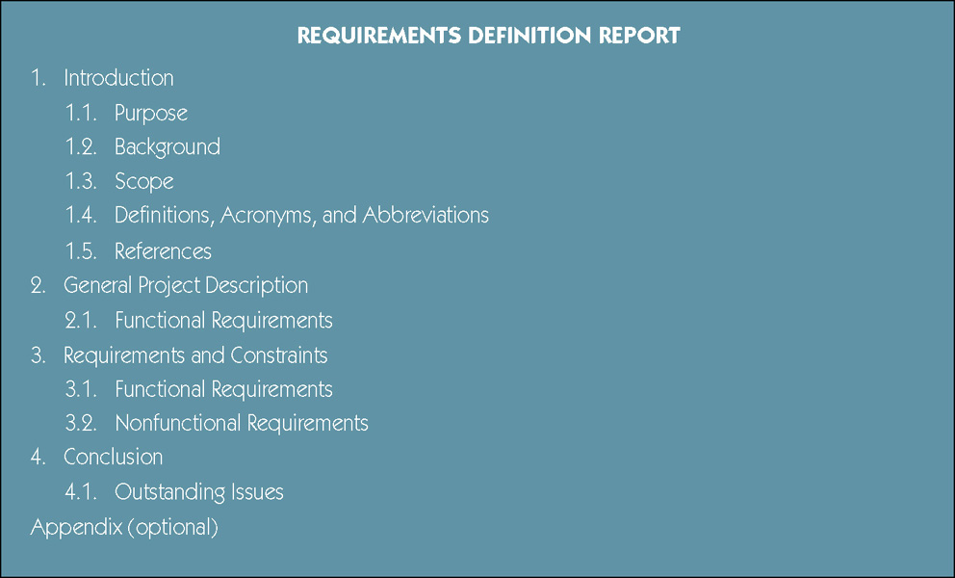
Sample Requirements Definition Report Outline
Notes:
Teaching Notes
There is no standard name or format for this document. In fact, many organizations use different names such as requirements statement, requirements specification, requirements definition, functional specification, etc., and the format is usually tailored to that organization’s needs.
For those companies that provide information systems and software to the U.S. government, the government requires that they use the format and naming conventions specified in their published standards document MIL-STD-498[1]. Many organizations have created their own standards adapted from MIL-STD-498 because of its thoroughness and because many people are already familiar with it.
In this book we will use the term requirements definition document .
[1] MIL-STD-498 is a standard that merges DOD-STD-2167A and DOD-STD-7935A to define a set of activities and documentation suitable for the development of both weapon systems and automated information systems.

Slide 15
Requirements Management
Requirements management - the process of managing change to the requirements.
  Over the lifetime of the project it is very common for new requirements to emerge and existing requirements to change.
  Studies have shown that over the life of a project as much as 50 percent or more of the requirements will change before the system is put into production.
Notes:
Teaching Notes
You might want to have the class brainstorm on some of the problems that can be caused by adding requirements later. These would include conflict with existing requirements, major changes to data structures that impacts other parts of the design, and schedule and budget concerns.
Requirements management encompasses the policies, procedures, and processes that govern how a change to a requirement is handled. In other words, it specifies how a change request should be submitted, how it is analyzed for impact to scope, schedule, and cost, how it’s approved or rejected, and how the change is implemented if approved.

Slide 16
Fact-Finding Ethics
Fact-Finding often brings systems analysts into contact with sensitive information.
  Company plans
  Employee salaries or medical history
  Customer credit card, social security, or other information
Ethical behavior
  Systems analysts must not misuse information.
  Systems analysts must protect information from people who would misuse it.
Otherwise
  Systems analyst loses respect, credibility, and confidence of users and management, impairing ability to do job
  Organization and systems analyst could have legal liability
  Systems analyst could lose job
Notes:
Teaching Notes
The instructor may want to share personal experiences about being in contact with sensitive information.

Slide 17
Seven Fact-Finding Methods
Sampling of existing documentation, forms, and databases.
Research and site visits.
Observation of the work environment.
Questionnaires.
Interviews.
Prototyping.
Joint requirements planning (JRP).
Notes:
Teaching Notes
Each will each be discussed later in the chapter.

Slide 18
Sampling Existing Documentation, Forms, & Files
Sampling –process of collecting a representative sample of documents, forms, and records.
  Organization chart
  Memos and other documents that describe the problem
  Standard operating procedures for current system
  Completed forms
  Manual and computerized screens and reports
  Samples of databases
  Flowcharts and other system documentation
  And more
Notes:
No additional notes.

Slide 19
Things to be Gleaned from Documents
Symptoms and causes of problems
Persons in organization who have understanding of problem
Business functions that support the present system
Type of data to be collected and reported by the system
Questions that need to be covered in interviews
Notes:
Conversion Notes
This is a new slide for the seventh edition
Teaching Notes
The instructor could bring in memos, organization charts, etc. (subject to fact-finding ethics) to demonstrate how these kinds of information could be gleaned from those documents.

Slide 20
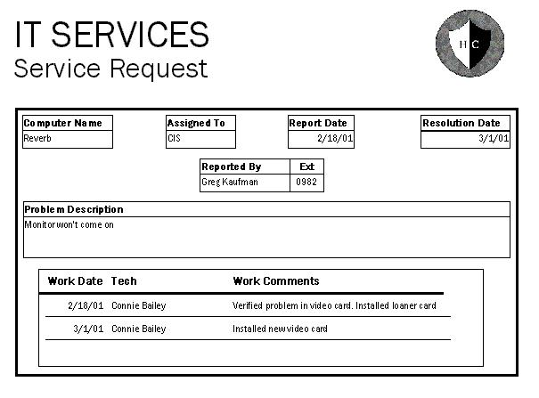
Why to Sample Completed Rather than Blank Forms
Can determine type of data going into each blank
Can determine size of data going into each blank
Can determine
which blanks
are not used
or not always
used
Can see data
relationships
Notes:
Teaching Notes
As an class exercise you can walk through this form from an old case study to see what the data tells you. Depending on the classes prior to familiarity with database concepts, this form can reveal:
That computer names are alphanumeric
That assigned to appears to be a 3-character initial
That Ext is a 4-digit extension number and not a full phone number
That the Problem Description is a large text area that sometimes contains only a few words.
That there is a one-to-many relationship between Service Requests and the work done on them.
That Work Comments is a large text area.

Slide 21
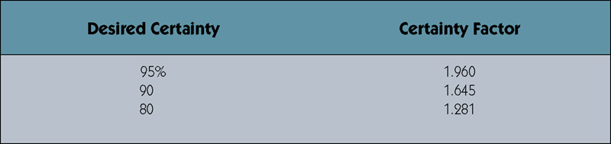
Determining Sample Size for Forms
Sample Size = 0.25 x (Certainty factor/Acceptable error) ²
Sample Size = 0.25(1.645/0.10) ² = 68
Sample Size =0.10(1 – 0.10)(1.645/0.10)² = 25
Or if analyst knows 1 in 10 varies from norm.
Certainty factor from certainty table. 10% acceptable error.
Notes:
Teaching Notes
Two versions of the sampling formula are provided in the textbook. The first uses a heuristic (.25) to calculate the sample size and the second replaces the (.25) with p(1-p) to reflect the knowledge of errors in the sample population. Review each with students and calculate various sample sizes using different levels of certainty.

Slide 22
Sampling Techniques
Randomization – a sampling technique
characterized by having no predetermined
pattern or plan for selecting sample data.
Stratification – a systematic sampling technique that attempts to reduce the variance of the estimates by spreading out the sampling—for example, choosing documents or records by formula—and by avoiding very high or low estimates.
Notes:
Teaching Notes
For randomization you just randomly choose the number of sample items based on the sample size calculated.
For computerized files, stratification sampling can be executed by writing a simple program. For instance, suppose invoices were stored in a database that had a volume of approximately 250,000. If the required sample size was 25, a program could be written that prints every 10,000th record (=250,000/25).

Slide 23
Observation
Observation – a fact-finding technique wherein the systems analyst either participates in or watches a person perform activities to learn about the system.
  Advantages?
  Disadvantages?
Work sampling - a fact-finding technique that involves a large number of observations taken at random intervals.
Notes:
Teaching Notes
This technique is often used when the validity of data collected through other methods is in question or when the complexity of certain aspects of the system prevents a clear explanation by the end-users.
Have students review The Railroad Paradox by Gerald M. Weinberg. Discuss the moral of the story.
Have students provide advantages and disadvantages of observation.

Slide 24
Observation
Advantages
Disadvantages
Data gathered can be very reliable
Can see exactly what is being done in complex tasks
Relatively inexpensive compared with other techniques
Can do work measurements
People may perform differently when being observed
Work observed may not be representative of normal conditions
Timing can be inconvenient
Interruptions
Some tasks not always performed the same way
May observe wrong way of doing things
Notes:
Conversion Notes
This is a new slide in the seventh edition.

Slide 25
Observation Guidelines
Determine the who, what, where, when, why, and how of the observation.
Obtain permission from appropriate supervisors.
Inform those who will be observed of the purpose of the observation.
Keep a low profile.
Take notes.
Review observation notes with appropriate individuals.
Don't interrupt the individuals at work.
Don't focus heavily on trivial activities.
Don't make assumptions.
Notes:
No additional notes.

Slide 26
Questionnaires
Questionnaire – a special-purpose document that allows the analyst to collect information and opinions from respondents.
Free-format questionnaire – a questionnaire designed to offer the respondent greater latitude in the answer. A question is asked, and the respondent records the answer in the space provided after the question.
Fixed-format questionnaire – a questionnaire containing questions that require selecting an answer from predefined available responses.
Notes:
Teaching Notes
Have students provide advantages and disadvantages of observation.
Have students provide examples of both free-format and fixed-format questions. The difference between the two is essentially the difference between a multiple-choice and essay exam.

Slide 27
Questionnaires
Advantages
Disadvantages
Often can be answered quickly
People can complete at their convenience
Relatively inexpensive way to gather data from a large number
Allow for anonymity
Responses can be tabulated quickly
Return rate is often low
No guarantee that an individual will answer all questions
No opportunity to reword or explain misunderstood questions
Cannot observe body language
Difficult to prepare
Notes:
Conversion Notes
This is a new slide in the seventh edition.

Slide 28
Types of Fixed-Format Questions
Multiple-choice questions
Rating questions
Ranking questions
Rank the following transactions according to the amount of time you spend processing them.
___ % new customer orders
___ % order cancellations
___ % order modifications
___ % payments
The implementation of quality discounts would cause an increase in customer orders.
___ Strongly agree
___ Agree
___ No opinion
___ Disagree
___ Strongly disagree
Is the current accounts receivable report that you receive useful?
___ Yes
___ No
Notes:
Teaching Notes
Ask students to classify each of the sample questions.
For multiple-choice questions, the respondent is given several answers. The respondent should be told if more than one answer might be selected.
For rating questions, the respondent is given a statement and asked to use supplied responses to state an opinion. To prevent built-in bias, there should be an equal number of positive and negative ratings.
For ranking questions, the respondent is given several possible answers, which are to be ranked in order of preference or experience.

Slide 29
Developing a Questionnaire
Determine what facts and opinions must be collected and from whom you should get them.
Based on the facts and opinions sought, determine whether free- or fixed-format questions will produce the best answers.
Write the questions.
Test the questions on a small sample of respondents.
Duplicate and distribute the questionnaire.
Notes:
No additional notes.

Slide 30
Interviews
Interview - a fact-finding technique whereby the systems analysts collect information from individuals through face-to-face interaction.
  Find facts
  Verify facts
  Clarify facts
  Generate enthusiasm
  Get the end-user involved
  Identify requirements
  Solicit ideas and opinions
The personal interview is generally recognized as the most important and most often used fact-finding technique.
Notes:
Teaching Notes
Have students provide advantages and disadvantages of interviews.

Slide 31
Types of Interviews and Questions
Unstructured interview –conducted with only a general goal or subject in mind and with few, if any, specific questions. The interviewer counts on the interviewee to provide a framework and direct the conversation.
Structured interview –interviewer has a specific set of questions to ask of the interviewee.
Open-ended question – question that allows the interviewee to respond in any way.
Closed-ended question – a question that restricts answers to either specific choices or short, direct responses.
Notes:
Teaching Notes
An unstructured interview frequently gets off track, and the analyst must be prepared to redirect the interview back to the main goal or subject. For this reason, unstructured interviews don't usually work well for systems analysis and design.
Have students provide examples of open-ended and closed-ended questions.

Slide 32
Interviews
Advantages
Disadvantages
Give analyst opportunity to motivate interviewee to respond freely and openly
Allow analyst to probe for more feedback
Permit analyst to adapt or reword questions for each individual
Can observe nonverbal communication
Time-consuming
Success highly dependent on analyst's human relations skills
May be impractical due to location of interviewees
Notes:
Conversion Notes
This slide is new in the seventh edition.

Slide 33
Procedure to Conduct an Interview
Select Interviewees
  End users
  Learn about individual prior to the interview
Prepare for the Interview
  interview guide
Conduct the Interview
  Summarize the problem
  Offer an incentive for participation
  Ask the interviewee for assistance
Follow Up on the Interview
  Memo that summarizes the interview
Notes:
No additional notes.

Slide 34
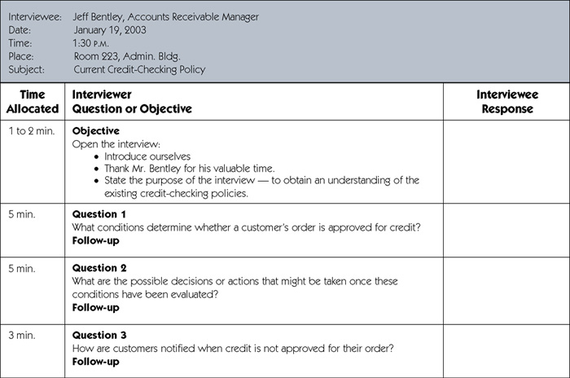
Sample Interview Guide
(continued)
Notes:
No additional notes.

Slide 35
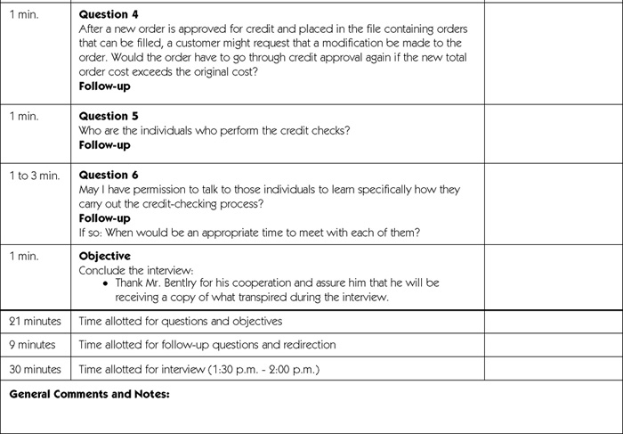
Sample Interview Guide (concluded)
Notes:
No additional notes.

Slide 36
Prepare for the Interview
Types of Questions to Avoid
  Loaded questions
  Leading questions
  Biased questions
Interview Question Guidelines
  Use clear and concise language.
  Don’t include your opinion as part of the question.
  Avoid long or complex questions.
  Avoid threatening questions.
  Don’t use “you” when you mean a group of people.
Notes:
Teaching Notes
Have students provide examples of loaded, leading, and biased questions.

Slide 37
Conduct the Interview
Dress to match interviewee
Arrive on time
  Or early if need to confirm room setup
Open interview by thanking interviewee
State purpose and length of interview and how data will be used
Monitor the time
Ask follow-up questions
  Probe until you understand
  Ask about exception conditions ("what if...")
Notes:
Conversion Notes
This is a new slide in the seventh edition.

Slide 38
Interviewing Do’s and Don’ts
Do
Don't
Dress appropriately
Be courteous
Listen carefully
Maintain control of the interview
Probe
Observe mannerisms and nonverbal communication
Be patient
Keep interviewee at ease
Maintain self-control
Finish on time
Assume an answer is finished or leading nowhere
Reveal verbal and nonverbal clues
Use jargon
Reveal personal biases
Talk more than listen
Assume anything about the topic or the interviewee
Tape record (take notes instead)
Notes:
Teaching Notes
Discuss with the students each of the items and the reasons for their classifications.

Slide 39
Body Language and Proxemics
Body language – the nonverbal information we communicate.
  Facial disclosure
  Eye contact
  Posture
Proxemics – the relationship between people and the space around them.
  Intimate zone—closer than 1.5 feet
  Personal zone—from 1.5 feet to 4 feet
  Social zone—from 4 feet to 12 feet
  Public zone—beyond 12 feet
Notes:
Teaching Notes
Research studies have determined a startling fact — of a person's total feelings, only 7 percent are communicated verbally (in words), 38 percent are communicated by the tone of voice used, and 55 percent of those feelings are communicated by facial and body expressions.
Certain types of communications take place only in some of these zones. For example, an analyst conducts most interviews with system users in the personal zone. But the analyst may need to move back to the social zone if the user displays any signs (body language) of being uncomfortable. Sometimes increasing eye contact can make up for a long distance that can't be changed. Many people use the fringes of the social zone as a “respect” distance.

Slide 40
Discovery Prototyping
Discovery prototyping – the act of building a small-scale, representative or working model of the users’ requirements in order to discover or verify those requirements.
Notes:
Teaching Notes
Discovery prototyping is frequently applied to systems development projects, especially in those cases where the development team is having problems defining the system requirements. The philosophy is that the users will recognize their requirements when they see them.
Have students provide advantages and disadvantages of discovery prototyping.

Slide 41
Discovery Prototyping
Advantages
Disadvantages
Can experiment to develop understanding of how system might work
Aids in determining feasibility and usefulness of system before development
Serves as training mechanism
Aids in building test plans and scenarios
May minimize time spent on fact-finding
Developers may need to be trained in prototyping
Users may develop unrealistic expectations
Could extend development schedule
Notes:
Conversion Notes
This is a new slide in the seventh edition.

Slide 42
Joint Requirements Planning
Joint requirements planning (JRP) – a process whereby highly structured group meetings are conducted for the purpose of analyzing problems and defining requirements.
  JRP is a subset of a more comprehensive joint application development or JAD technique that encompasses the entire systems development process.
Notes:
Teaching Notes
JRP (and JAD) techniques are becoming increasingly common in systems planning and systems analysis to obtain group consensus on problems, objectives, and requirements.

Slide 43
JRP Participants
Sponsor
Facilitator
Users and Managers
Scribes
IT Staff
Notes:
Teaching Notes
Discuss the role of each. Be sure to focus on the skills needed to be a successful JRP facilitator.

Slide 44
Steps to Plan a JRP Session
Selecting a location
  Away from workplace when possible
  Requires several rooms
  Equipped with tables, chairs, whiteboard, overhead projectors
  Needed computer equipment
Selecting the participants
  Each needs release from regular duties
Preparing the agenda
  Briefing documentation
  Agenda distributed before each session
Notes:
Teaching Notes
Discuss why the JRP session location should be held off-site.
Discuss why many companies opt to hire qualified JRP facilitators from outside the organization.

Slide 45
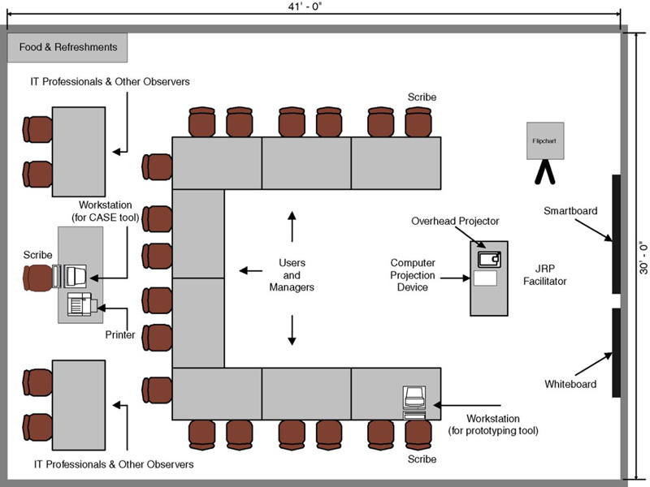
Typical Room Layout for JRP session
Notes:
Teaching Notes
Discuss the seating arrangement of the participants as well as where the equipment is located. Also solicit the opinions of students in the way of providing refreshments. Do they think it is necessary?

Slide 46
Guidelines for Conducting a JRP Session
Do not unreasonably deviate from the agenda
Stay on schedule
Ensure that the scribe is able to take notes
Avoid the use of technical language
Apply conflict resolution skills
Allow for plentiful breaks
Encourage group agreement
Encourage user and management participation without allowing individuals to dominate the session
Make sure that attendees stand by the established ground rules for the session
Notes:
No additional notes.

Slide 47
Brainstorming
Sometimes, one of the goals of a JRP session is to generate possible ideas to solve a problem.
  Brainstorming is a common approach that is used for this purpose.
Brainstorming – a technique for generating ideas by encouraging participants to offer as many ideas as possible in a short period of time without any analysis until all the ideas have been exhausted.
Notes:
No additional notes.

Slide 48
Brainstorming Guidelines
Isolate appropriate people in a place that free from distractions and interruptions.
Make sure everyone understands purpose of the meeting.
Appoint one person to record ideas.
Remind everyone of brainstorming rules.
Within a specified time period, team members call out their ideas as quickly as they can think of them.
After group has run out of ideas and all ideas have been recorded, then and only then should ideas be evaluated.
Refine, combine, and improve ideas generated earlier.
Notes:
Teaching Notes
Be sure to discuss the rules of brainstorming:
Be spontaneous. Call out ideas as fast as they occur.
Absolutely no criticism, analysis, or evaluation of any kind is permitted while the ideas are being generated. Any idea may be useful, if only to spark another idea.
Emphasize quantity of ideas, not necessarily quality.

Slide 49
Benefits of JRP
JRP actively involves users and management in the development project (encouraging them to take “ownership” in the project).
JRP reduces the amount of time required to develop systems.
When JRP incorporates prototyping as a means for confirming requirements and obtaining design approvals, the benefits of prototyping are realized
Notes:
Teaching Notes
Discuss the reasons why JRP reduces the amount of time required to develop systems.
Note the differences between calendar time and person-hours. JRP may require more person-hours but reduces calendar time. Ask the students to name situations in which minimizing one or the other would be more important.

Slide 50
A Fact-Finding Strategy
Learn from existing documents, forms, reports, and files.
If appropriate, observe the system in action.
Given all the facts that already collected, design and distribute questionnaires to clear up things that aren’t fully understood.
Conduct interviews (or group work sessions).
(Optional). Build discovery prototypes for any functional requirements that are not understood or for requirements that need to be validated.
Follow up to verify facts.
Notes:
Teaching Notes
This is one possible strategy, but one that minimizes wasting user time.
An analyst needs an organized method for collecting facts. An inexperienced analyst will frequently jump right into interviews. “Go to the people. That's where the real facts are!'' Wrong! This attitude fails to recognize an important fact of life: people must complete their day-to-day jobs! Your job is not their main responsibility. Your demand on their time is their time and money lost.

