Slide 1
SJSU International House
Fire-Alarm / Evacuation Organization

Slide 2
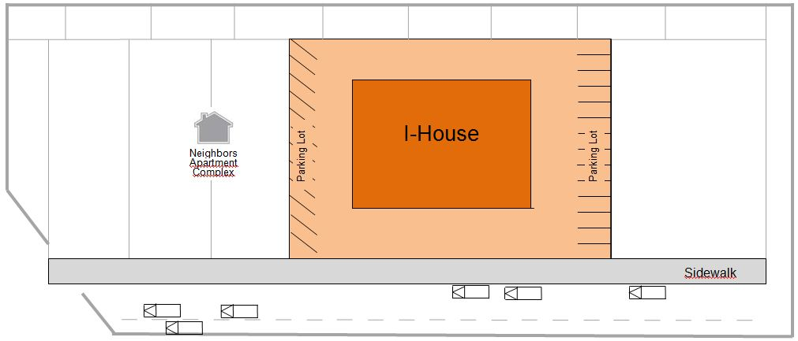
Situation Map

Slide 3
Goal: Sidewalk near the I-House

Slide 4
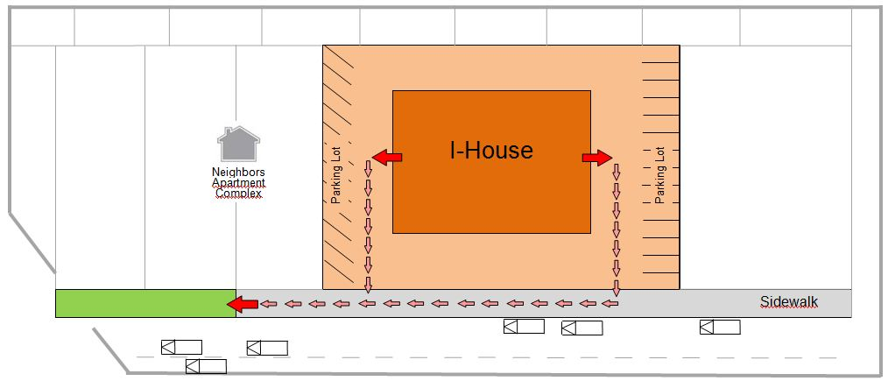
Way to the goal: via the side doors
Leave the red zone!!!
Go to the green zone.

Slide 5
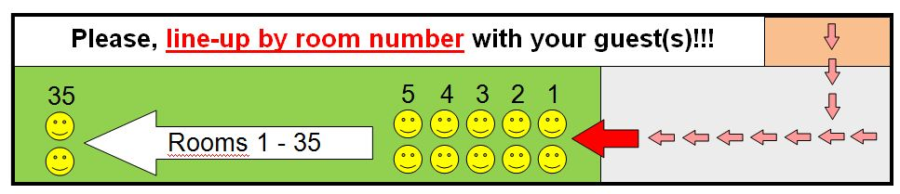
Behavior in the goal:
Stay in the green zone and line up

Slide 6
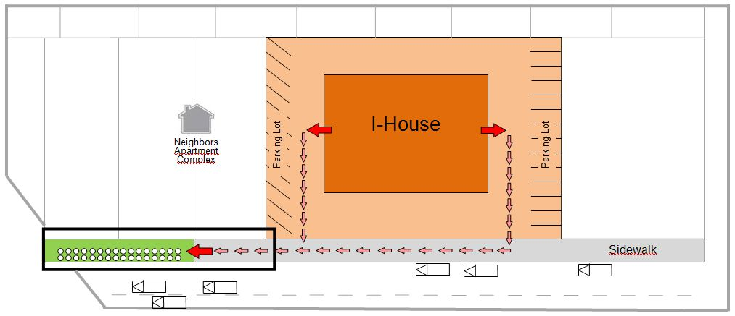
Summary
Goal: Sidewalk near the I-House
Way to the goal: via the sidedoors
Behavior in the goal: stay there and line up by room number

