Slide 1
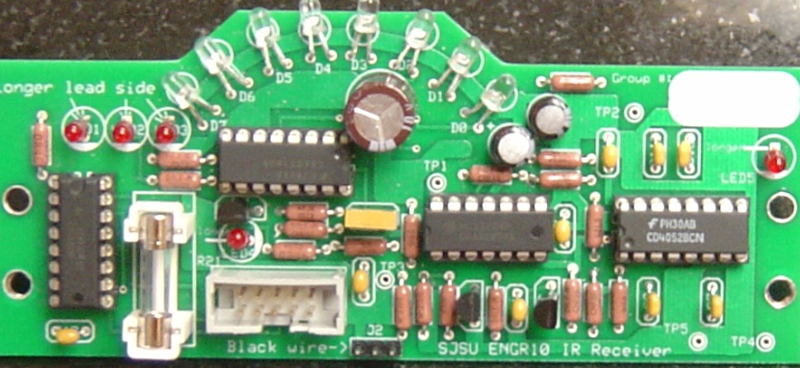
Robot Electronics

Slide 2
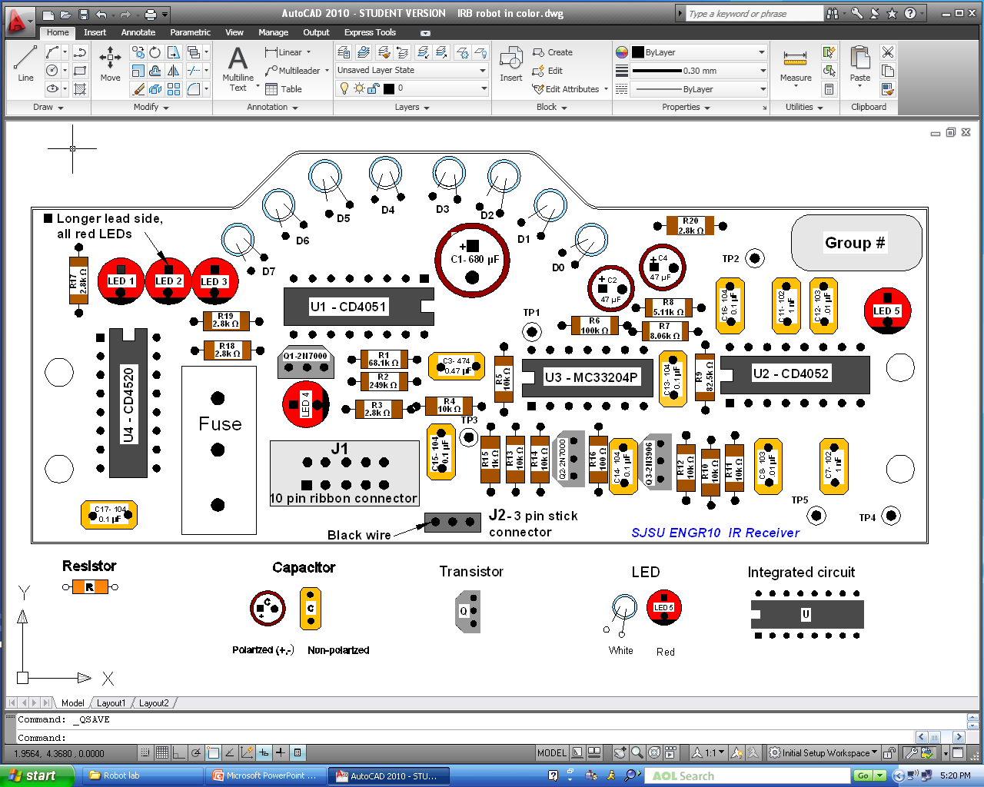
Robot Project - The IR board
ky
Resistors
Capacitors
Transistors
Infrared Detectors
LEDs
Integrated Circuits
Polarized (+,-)
Non-Polarized
R1 = 68.1k Ω R2 = 249k Ω
R3 = 2.8k Ω
R4 = 10k Ω
R5 = 10k Ω
R6 = 100k Ω
R7 = 8.06k Ω
R8 = 5.11k Ω R9 = 82.5k Ω
R10 = 10k Ω
R11 = 10k Ω
R12 = 10k Ω
R13 = 10k Ω
R14 = 10k Ω
R15 = 1k Ω R16 = 100 Ω
R17 = 2.8k Ω
R18 = 2.8k Ω
R19 = 2.8k Ω
R20 = 2.8k Ω
C1 = 10v 680 μF C2 = 10v 47 μF
C3 = 474, .47 μF C4 = 10v 47 μF
C7 = 102, 1 nF
C8 = 103, .01 μF
C11 = 102, 1 nF
C12 = 103, .01 μF
C13 = 104, .1 μF
C14 = 104, .1 μF
C15 = 104, .1 μF
C16 = 104, .1 μF
C17 = 104, .1 μF
Short lead
Q1 = 2N7000 Q2 = 2N7000
Q3 = 2N3906
Long lead
5 – red
color
U1 = CD4051, 16-pin U2 = CD4052, 16-pin
U3 = MC33204P, 14-pin
U4 = CD4520, 16-pin
8 – white color

Slide 3
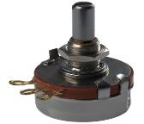
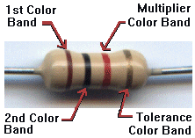
Resistors
Resistors are passive elements that oppose/restrict the flow of current.
A voltage is developed across its terminal, proportional to the current through the resistor.
V = IR
Units: Ohms (Ω)
Variable resistor (potentiometer)
Resistor ID and values for the IRB
Component ID | Value | Marking
R15 | 1k Ω | 1k 1%
R4,5,10,11,12,13,14 | 10k Ω | 10k 1%
R6 | 100k Ω | 100k 1%
R16 | 100Ω | 100Ω 1%
R3, 17,18,19,20 | 2.8k Ω | 2.8k 1%
R2 | 249k Ω | 249k 1%
R8 | 5.11k Ω | 5.11k 1%
R1 | 68.1k Ω | 68.1k 1%
R7 | 8.06k Ω | 8.06k 1%
R9 | 82.5k Ω | 82.5k 1%
Constant resistor

Slide 4
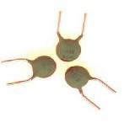
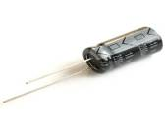

Capacitors
Store energy and release it later (small battery)
(store energy and release it later. )
are made of two parallel conductors separated by a
dielectric.
are used for filtering, tuning, separating signals , etc.
The ability of a capacitor to store charge is called
“Capacitance”
C = Q/V (amount of charge stored/applied voltage)
The unit of capacitance is the Farad.
Commonly used capacitances are much smaller than 1
Farad, micro-Farads (10⁻⁶ Farad, μF),
nano-Farads (10⁻⁹ Farad, nF),
pico-Farads (10⁻¹² Farad, pF).

Slide 5
Capacitor ID numbers, capacitances, and markings on the capacitors
Component ID | Value | marking | Remark
C2, 4 | 47μF | 47μF 10v | polarized
C1 | 680uF | 10v 480μF | polarized
C7, C11 | 1nF | 102 | Not polarized
C8, C12 | .01μF | 103 | Not polarized
C13, 14, 15, 16, 17 | 0.1μF | 104 | Not polarized
C3 | 0.47μF | 474 | Not polarized

Slide 6


Transistors
Transistors are commonly used for signal amplification, switching, voltage regulation, etc.
Symbol for the NPN Transistor
collector
base
Transistor ID numbers, types, and markings on the transistors.
emitter
Transistor ID | Transistor type | Marking
Q1, Q2 | 2N7000 | 2N7000
Q3 | 2N3906 | 2N3906
Symbol for the PNP Transistor

Slide 7
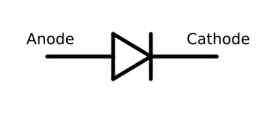

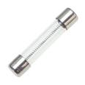
Diodes are semiconductor devices that allow
current in only one direction
Fuses are devices that protect the circuit from overload.

Slide 8
LEDs- Light Emitting Diodes:
A special kind of diode: They allow current to
flow in one direction.
The LED will light up when the proper amount of
current passes through.
1-3
4
5

Slide 9
Infrared Detectors
The appearance of these infrared photo detectors and the
internal structure is similar to that of an LED.
The infrared photo detector has a focal direction, and the
detection angle is about 15°. (8x15=120˚)
This small detection angle allows the controller to tell the
direction where the infrared light comes from.

Slide 10
Sockets for Integrated Circuits
Must be soldered in position before the ICs are inserted
IC socket ID numbers and type.
Component ID | Type | Marking
U3 | DIP14 socket | 14-pin
U1, 2, 4 | DIP16 socket | 16-pin

Slide 11
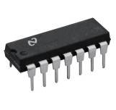
Integrated Circuits
IC parts number and function.
Orientation
ID | Parts number | Function
U1 | CD4051 | 8 to 1 multiplexer
U2 | CD4052 | Due 4 to 1 multiplexer
U3 | MC33204P | Rail-to-Rail Op Amp
U4 | CD4520 | Counter
Selector
Amplifier
Counter
Tuning CKT

Slide 12
  Connectors
There are two connectors on the board – J1 and J2. J1 is a 10-pin ribbon cable connector. J2 is a 3-pin stick connector. J1 should be placed according to Figure 12. J2 can be placed in either orientation but the shorter pin side should be placed into the holes. You will see a place on the circuit board labeled for J3. For this project, J3 is not used.

